Slide 2
A FRAMEWORK FOR PARAMETRIC DIMENSIONALITY REDUCTION
ParaDime
Andreas Hinterreiter, Christina Humer, Bernhard Kainz, Marc Streit
EuroVis 2023

Slide 3
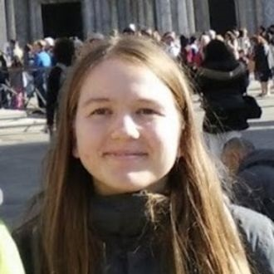
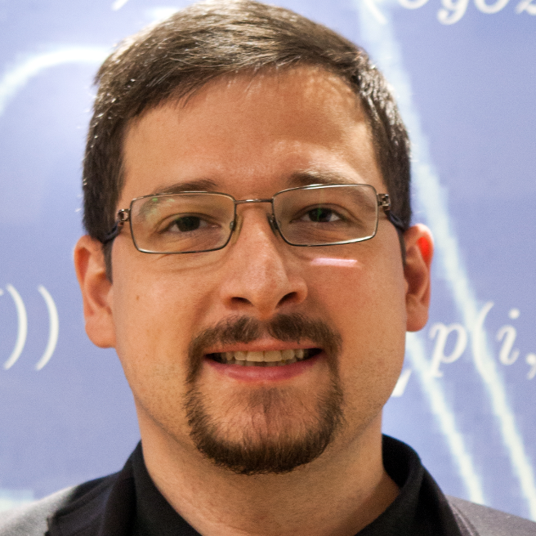
TEAM
Andreas Hinterreiter
Christina Humer
Bernhard Kainz
Marc Streit
2

Slide 4
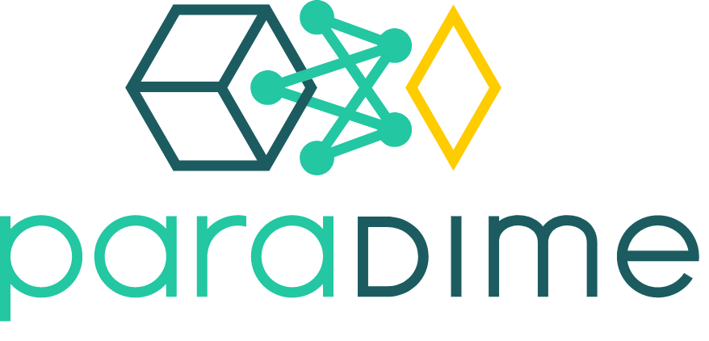
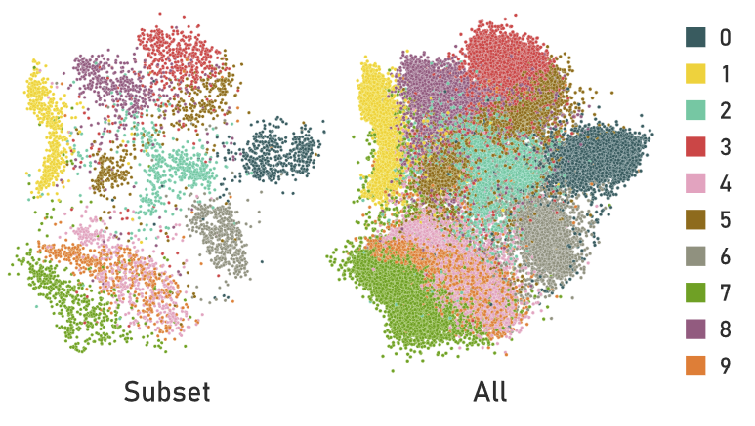
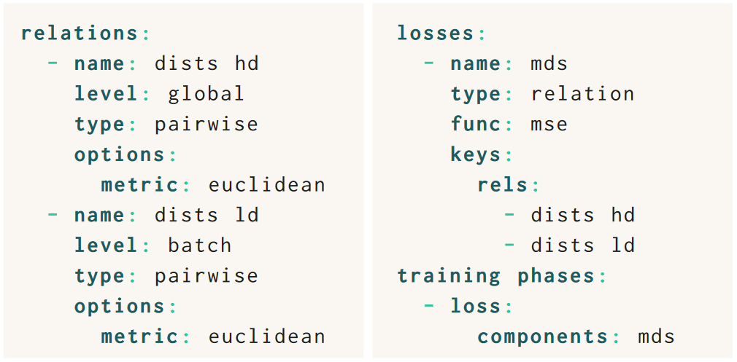
3
Notes:
So to wrap things up: ParaDime is a framework for parametric dimensionality reduction. It unifies existing techniques, but also allows users to customize them and experiment with new ideas.
To this end ParaDime introduced specifications based on a grammar of dimensionality reduction.
If you want to learn more about ParaDime, this QR code will take you to the paper website that also includes links to the docs and the source code.
Thanks for listening and I hope you‘ll check out ParaDime.

Slide 5
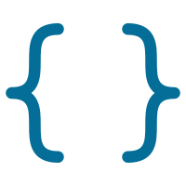
MOTIVATION & GOALS
Unify
Parameterize
Share & Reuse
Customize
4

Slide 6
MOTIVATION & GOALS
Unify
Parameterize
Share & Reuse
Customize
4
Notes:
I want to start with the general motivation behind our work. ParaDime is a framework for parametric dimensionality reduction. Because dimensionality reduction is quite a mouthful, I‘ll be mostly calling it DR for the rest of the presentation.
The development of ParaDime was guided by four principles.
First, we wanted to unify existing DR techniques. We had noticed that some existing techniques share a lot of ideas and principles with each other, and we wanted to provide a common framework for them.
Second, we wanted to extend these techniques to be parametric. We found that parametric extensions of DR techniques can be quite handy in some cases, yet it was still a bit of an underexplored area in our opinion.
I‘ll explain later in more detail when and how parametric DR techniqes can be beneficial.
Third, we wanted users to be able to customize these techniques, to make it easy for them to experiment with new ideas. By the end of this video, you‘ll hopefully have an idea of the different customizations that are possible with ParaDime.
Finally, we wanted users to be able to share and reproduce their ideas. Here we took inspiration from grammars that have become quite popular in the vis community, so we created our own grammar of dimensionality reduction.

Slide 7
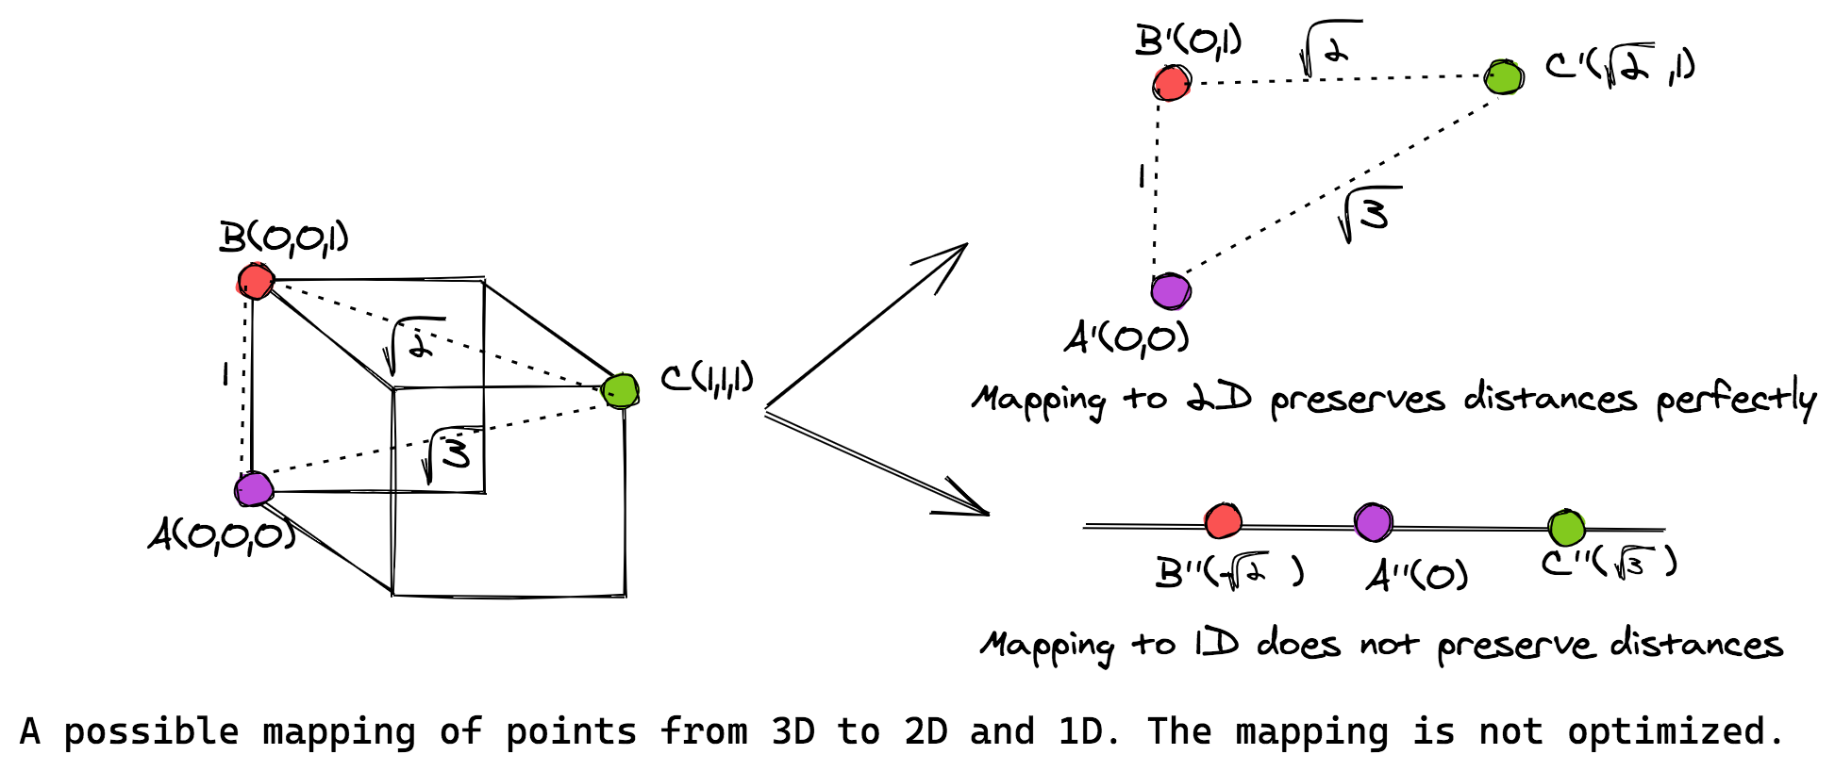
SIMILARITIES BETWEEN METHODS
MDS
Isomap
t-SNE
LargeVis
UMAP
https://stackabuse.com/guide-to-multidimensional-scaling-in-python-with-scikit-learn/
5
Notes:
First I want to talk in a bit more detail about the similarities between various DR techniques.
I‘m going to start with multidimensional scaling or MDS, one of the simplest and oldest DR techniques alongside PCA.
In particular, I want to talk about „metric“ MDS.
Let‘s say we have some high-dimensional points that we want to embed in a lower dimensional space.
For metric MDS, we basically compute the pairwise distances in the high-dimension.
Then, we try to arrange a set of low-dimensional points in such a way that their pairwise distances are as similar to those of the high-dimensional ones as possible.
In some cases we can restore the exact positions of points this way, like in this example when we embed in 2D space.
But usually we lose some information when we reduce the dimensionality, like in this example when we go all the way down to 1D.
But the basic principle is to try and preserve pairwise distances.

Slide 8
SIMILARITIES BETWEEN METHODS
MDS
Isomap
t-SNE
LargeVis
UMAP
Tenenbaum, J. B. (2000). A Global Geometric Framework for Nonlinear Dimensionality Reduction. Science, 290(5500), 2319–2323.
6
Notes:
Next, let‘s have a look at Isomap, another well-known DR technique.
Isomap basically works the same, but nstead of the actual Euclidean pairwise distances, we now compute geodesic distances.
These are the shortest paths between points on a neighbor graph. Here you can see an example of the geodesic distance between two points on the Siwss roll dataset.
From then on, Isomap is the same as MDS, in that we try to find a low-dimensional representation, but this time conserving the geodesic distances.

Slide 9
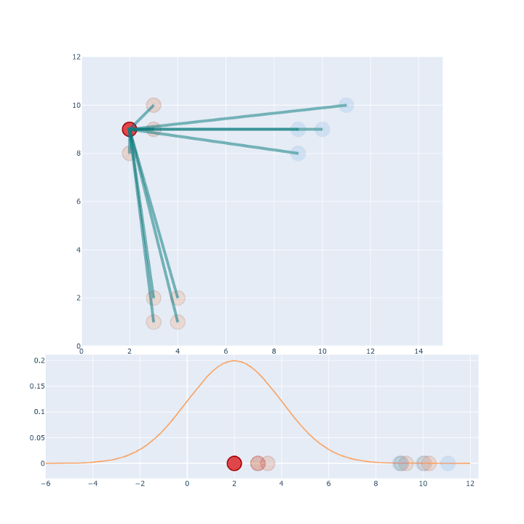
SIMILARITIES BETWEEN METHODS
MDS
Isomap
t-SNE
LargeVis
UMAP
https://towardsdatascience.com/t-sne-clearly-explained-d84c537f53a
7
Notes:
Finally, let‘s look at t-distributed neighbor embedding, or t-SNE for short.
Again, t-SNE basically works the same, but now we transform Euclidean distances into probabilities of neighborhood based on Gaussians of varying widths.
Here you can see one point with its distances to all its neighbors and on the right how those distances can be rescaled based on the Gaussian.
The final step in t-SNE is then to find a low-dimensional representation with neighborhoiod probabilities that are as similar as possible to those in the high-dimensional space.

Slide 10
SIMILARITIES BETWEEN METHODS
MDS
Isomap
t-SNE
LargeVis
UMAP
https://towardsdatascience.com/t-sne-clearly-explained-d84c537f53a
7
Notes:
You might also know LargeVis, which works in a very similar way to t-SNE.
And UMAP, even though it was originally framed in a slightly different way, is very similar too.
In UMAP, we just use some different kernels to transform distances into neighborhood probabilities.

Slide 11
SIMILARITIES BETWEEN METHODS
MDS
Isomap
t-SNE
LargeVis
UMAP
Summary
Compute distances in high-dimensional space
Optionally transform HD distances
Arrange points in low-dimensional space and compute distances
Optionally transform LD distances
Make (transformed) distances match
8
Notes:
So in summary, for these existing DR techniques the general process is the following.
Compute distances in the high-dimensional space;
Optionally transform these distances; and
Arrange points in the low-dimensional space in such a way that the (possibly transformed) pairwise distances match as well as possible.
And this is the general principle behind how DR works in ParaDime. But I‘ll talk about this in more detail in a second.
First I want to address the second goal, namely making embeddings parametric.

Slide 12
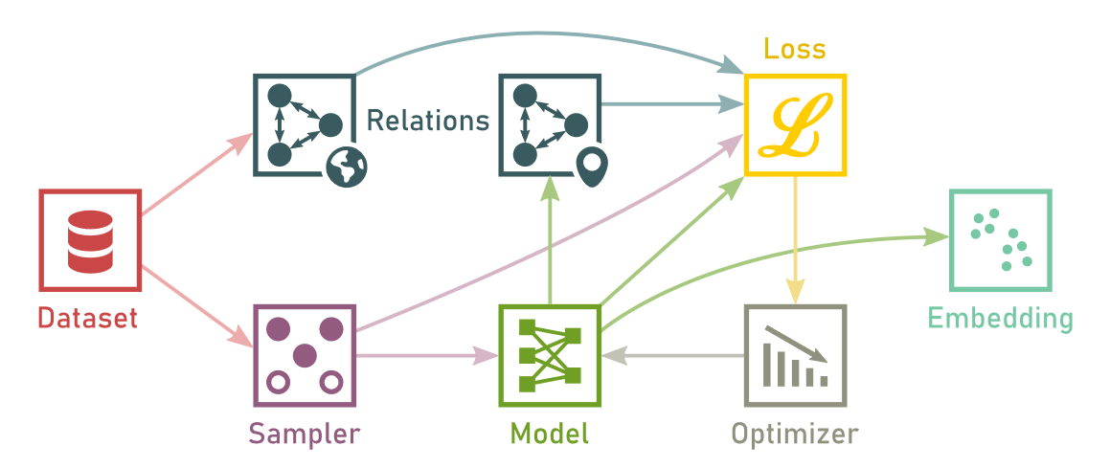
DATA FLOW
9
Notes:
Next, I‘ll explain how we combined the general principle of DR that I discussed earlier with the idea of making DR parametric.
This is the dataflow in ParaDime.
We start with a training dataset and we first compute „relations“ on the whole dataset. We call these relations global relations and they‘re indicated here by this little globe icon.
Relations are generalized distances between the data points. This notion of relations allows us to cover all the tranformations of distances used in the techniques that I discussed in the first part of the presentation.
Next, we sample batches of data points and feed them to a model. The model is the parametrized function that I mentioned earlier. In ParaDime this is typically a neural network.
For the model output, which is usually a set of low-dimensional coordinates, we also compute relations between them. But now it‘s just on a batch level instead of relations between all the data points.
We then feed the global relations, the batch-wise relations (and in some cases parts of the original sampled data) to a loss function that is optimized. After a couple of optimization loops we obtain our embedding function.
In ParaDime, we call this whole process a DR „routine“.

Slide 13
MOTIVATION & GOALS
Unify
Parameterize
Share & Reuse
Customize
10
Notes:
I want to start with the general motivation behind our work. ParaDime is a framework for parametric dimensionality reduction. Because dimensionality reduction is quite a mouthful, I‘ll be mostly calling it DR for the rest of the presentation.
The development of ParaDime was guided by four principles.
First, we wanted to unify existing DR techniques. We had noticed that some existing techniques share a lot of ideas and principles with each other, and we wanted to provide a common framework for them.
Second, we wanted to extend these techniques to be parametric. We found that parametric extensions of DR techniques can be quite handy in some cases, yet it was still a bit of an underexplored area in our opinion.
I‘ll explain later in more detail when and how parametric DR techniqes can be beneficial.
Third, we wanted users to be able to customize these techniques, to make it easy for them to experiment with new ideas. By the end of this video, you‘ll hopefully have an idea of the different customizations that are possible with ParaDime.
Finally, we wanted users to be able to share and reproduce their ideas. Here we took inspiration from grammars that have become quite popular in the vis community, so we created our own grammar of dimensionality reduction.

Slide 14
PARAMETRIC EMBEDDINGS
Non-parametric embeddings:
Parametric embeddings:
11
Notes:
In the traditional, non-parametric embeddings that I just talked about, you can think of the DR process as a minimization of a loss function over a configuration of points.
Here, the x_i are the high-dimensional points, and the y_i are the low-dimensional ones.
You can already see that when the original points change just a little bit, or when we add some new points, we have to do the whole minimization again.
In paramtric embedings, in contrast, we minimize the same loss over a family of parametric functions (here capital F). These could be neural networks, for example.
This way we obtain a function (small f) that we can simply apply to new points on the fly.

Slide 15
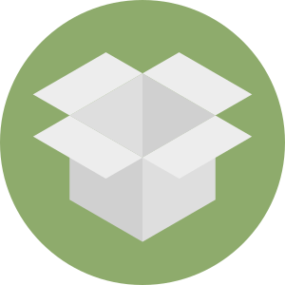
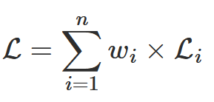
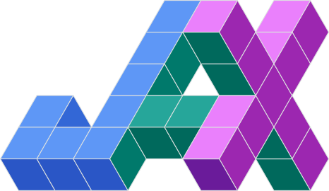
PARAMETRIC EMBEDDINGS
Out-of-sample extension
Potentially explainable
Modern infrastructure
Differentiable
Customizable
12
Notes:
Therefoer, one og the main advantages of parametric embeddings is the built-in out-of-sample-extension. We can obtain a function that performs our DR from a subset of points and then apply it to the whole dataset, as seen in this example for t-SNE and the MNIST handwritten digits dataset.
If we choose a suitable set of functions, such as neural networks, these functions are differentiable. This means that we can simply use gradient descent for the minimization.
It also turns out that it‘s really simple to add extra loss components to the original embedding losses, making parametric DR easily customizable.
I‘ll go into more details on that later with some concrete examples.
Parametric DR also has the advantage that it is potentially explainable. We can either limit ourselves to a set of specific white-box functions that are intrinsically explainable.
Or we can apply any existing XAI technique to the DR that has been developed for our family of black-box functions.
In ParaDime specifically, we can use any XAI method for neural networks.
Finally, making the DR parametric in this way allows us to use modern infrastructure for machine learning, such as the PyTorch, TensorFlow or JAX frameworks. For ParaDime, we chose PyTorch.

Slide 16
MOTIVATION & GOALS
Unify
Parameterize
Share & Reuse
Customize
13
Notes:
I want to start with the general motivation behind our work. ParaDime is a framework for parametric dimensionality reduction. Because dimensionality reduction is quite a mouthful, I‘ll be mostly calling it DR for the rest of the presentation.
The development of ParaDime was guided by four principles.
First, we wanted to unify existing DR techniques. We had noticed that some existing techniques share a lot of ideas and principles with each other, and we wanted to provide a common framework for them.
Second, we wanted to extend these techniques to be parametric. We found that parametric extensions of DR techniques can be quite handy in some cases, yet it was still a bit of an underexplored area in our opinion.
I‘ll explain later in more detail when and how parametric DR techniqes can be beneficial.
Third, we wanted users to be able to customize these techniques, to make it easy for them to experiment with new ideas. By the end of this video, you‘ll hopefully have an idea of the different customizations that are possible with ParaDime.
Finally, we wanted users to be able to share and reproduce their ideas. Here we took inspiration from grammars that have become quite popular in the vis community, so we created our own grammar of dimensionality reduction.

Slide 17
DATA FLOW
14
Notes:
Next, I‘ll explain how we combined the general principle of DR that I discussed earlier with the idea of making DR parametric.
This is the dataflow in ParaDime.
We start with a training dataset and we first compute „relations“ on the whole dataset. We call these relations global relations and they‘re indicated here by this little globe icon.
Relations are generalized distances between the data points. This notion of relations allows us to cover all the tranformations of distances used in the techniques that I discussed in the first part of the presentation.
Next, we sample batches of data points and feed them to a model. The model is the parametrized function that I mentioned earlier. In ParaDime this is typically a neural network.
For the model output, which is usually a set of low-dimensional coordinates, we also compute relations between them. But now it‘s just on a batch level instead of relations between all the data points.
We then feed the global relations, the batch-wise relations (and in some cases parts of the original sampled data) to a loss function that is optimized. After a couple of optimization loops we obtain our embedding function.
In ParaDime, we call this whole process a DR „routine“.

Slide 18
GRAMMAR & SPECIFICATIONS
15
Notes:
We developed a grammar that allows users to specify such routines in a simple syntax. For the paper and this presentation, we chose YAML for the specifications, but in practice JSON works just as well.
Let me explain a simple specification for metric MDS to give you an idea of what that looks like.
On the base level, one of the things we define is the way the relations are computed.
Here, we first have the global relations, which are just pairwise euclidean distances.
We also have the batch-wise relations, which are again imply pairwise euclidean distances in the case of metric MDS.
We also set up the loss function. There are several different types of losses in ParaDime. I‘ll get to that later. For now, we just use a relation type loss that compares global and batch-wise relations using the mean square error.
Finally, we organize the training (that is, the optimization) into phases. For MDS, we only need onephase though and that phase just uses the MDS loss defined above.
In ParaDime, you just load such a specification, define a PyTorch model and a dataset and you‘re ready to go.

Slide 19
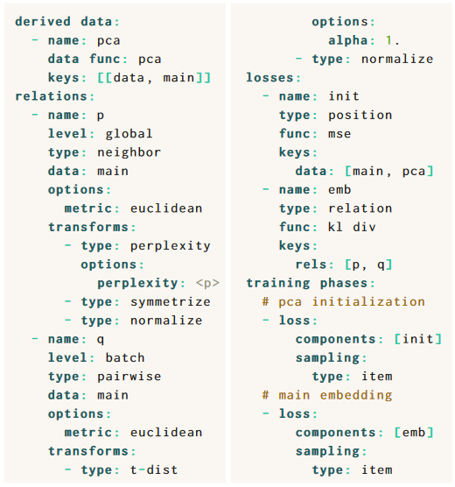
GRAMMAR & SPECIFICATIONS
16
Notes:
Earlier, I briefly showed you an example of a parametric t-SNE routine. This is what the specification for that looks like. I won‘t go into too much detail here, but you can notice that we set up some slightly more complex relations that are based on transformed distances. We also use multiple training phases to mimic an initialization of the coordinates with PCA, which is often used in modern t-SNE implementations. You can pause the video to have a closer look, or you can read about this example in more detail in our paper.

Slide 20
MOTIVATION & GOALS
Unify
Parameterize
Share & Reuse
Customize
17
Notes:
I want to start with the general motivation behind our work. ParaDime is a framework for parametric dimensionality reduction. Because dimensionality reduction is quite a mouthful, I‘ll be mostly calling it DR for the rest of the presentation.
The development of ParaDime was guided by four principles.
First, we wanted to unify existing DR techniques. We had noticed that some existing techniques share a lot of ideas and principles with each other, and we wanted to provide a common framework for them.
Second, we wanted to extend these techniques to be parametric. We found that parametric extensions of DR techniques can be quite handy in some cases, yet it was still a bit of an underexplored area in our opinion.
I‘ll explain later in more detail when and how parametric DR techniqes can be beneficial.
Third, we wanted users to be able to customize these techniques, to make it easy for them to experiment with new ideas. By the end of this video, you‘ll hopefully have an idea of the different customizations that are possible with ParaDime.
Finally, we wanted users to be able to share and reproduce their ideas. Here we took inspiration from grammars that have become quite popular in the vis community, so we created our own grammar of dimensionality reduction.

Slide 21
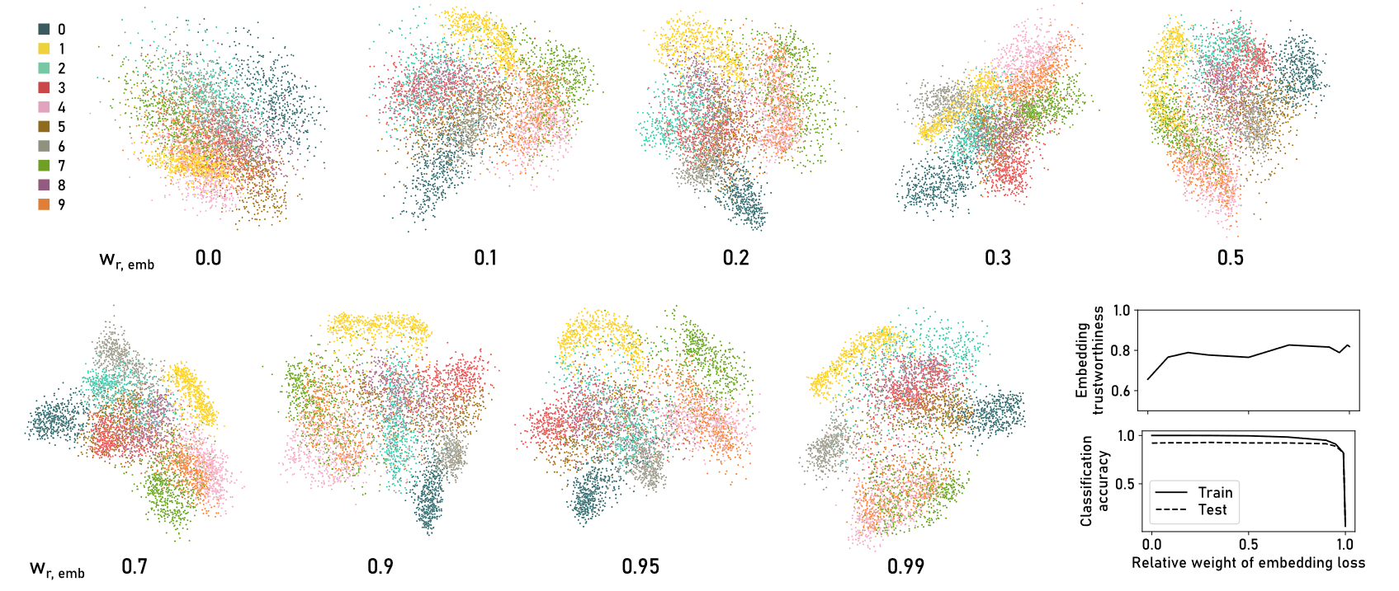
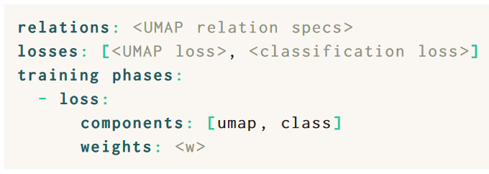
CUSTOMIZATION EXAMPLES
Hybrid/multitask routines
Classification
Reconstruction
Forest covertype Dataset
Multi-phase routines
Supervised routines
18
Notes:
Now I want to give you an idea of how the customization works in ParaDime.
One simple way to experiment with new DR ideas is to create hybrid or multitask routines.
These are routines where the model learns to perform two tasks at once, for example the DR and classification, or the DR and reconstruction, such as in an autoencoder.
Here is an example of how simple it is to combine these tasks in ParaDime: you just list the two individual losses (here, one for UMAP and one for classification) and they are automatically combined.
In the paper, you can find a detailed example of a routine that can classify and embed MNIST images at the same time.
Other customizations that are possible are multi-phase routines, where you would first run the optimization in one way, and then run a couple of more iterations with a different loss. This is really easy thanks to the organization of the training in phases.
Finally, supervised or semi-supervised DR is easily possible in ParaDime. I want to show you two different examples now for this family of techniques.
In both cases, we use the forest covertype dataset. This dataset includes cartographic variables from patches of land that can be used to predict the type of tree that is most prevalent on each patch.
And in both examples, we define a very simple loss and add it to a t-SNE loss with varying weights.

Slide 22
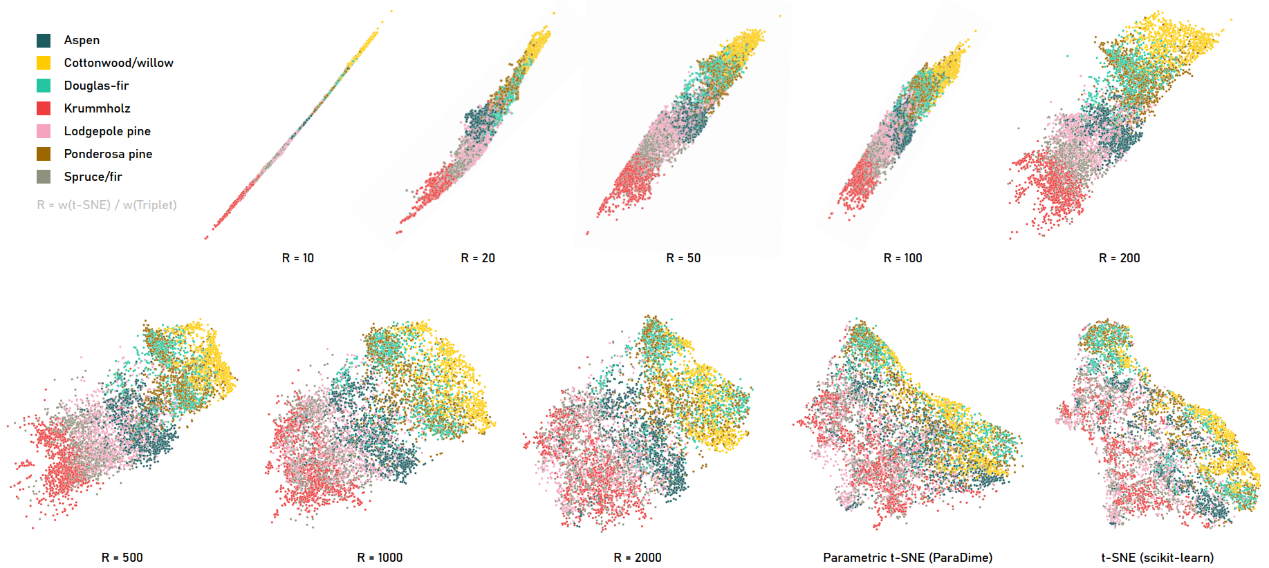
SUPERVISED DR – TRIPLETS
19
Notes:
Let‘s first look at the plain t-SNE embedding of the forest covertype dataset. You can see here that our parametric ParaDime embedding looks very similar to the traditional, non-parametric one.
In these scatterplots, the colors indicate the ground truth labels.
Now we define our additional loss based on triplets.
A triplet consists of one focus datapoint, together with one point with the same ground truth class and a third point with a different ground truth class.
The loss is then defined such that the two items with the same ground truth class should be close together, and the pair with different labels should be further apart.
Here you can see how it looks like when we use just this triplet loss. The points are simply placed along a line according to the labels.
But once we start to combine the t-SNE loss with the triplet loss using different weights, we can control how much our t-SNE embedding is supervised.
You can see that the intermediate combinations preserve the overall structure, while items with of the same class are kept together.
In an interactive tool, this could be useful for exploring datasets with a class focus without losing track of the global structure.

Slide 23
SUPERVISED DR – CORRELATION
20
Notes:
In this second example, we want to include the supevision not through the class labels, but through the values of one individual attribute (or feature) from among the high-dimensional data.
We simply define an additional loss that makes the x-axis of the output correlate witht the value of that feature. We will again combine this loss with the t-SNE los.
But first, let‘s again look at the plain parametric t-SNE. This time, the color indicates the value of the 8th feature, which is the hillshade at noon.
Now let‘s add our correlation loss.
Notice how the points start to morph in such a way that the values of the eighth feature are aligned along the x-axis.
Still, some of the overall structure is preserve, even when we put a lot of weight on the correlation loss. The points basically fold over to fulfill our constraint.
By the way, we call this type of supervision „attribute-guided“ embeddings in the paper.
I mentioned earlier that we can apply any existing XAI techniques to our neural-network-based embeddings. Here, to verify what happened to the x-axis, we calculated a simple feature importance.
The bar charts show that with the extra loss the eighth feature is indeed most important for the x-axis, while the y-axis is still used for a mix of features in a very similar way as in the plain t-SNE embedding.

Slide 24
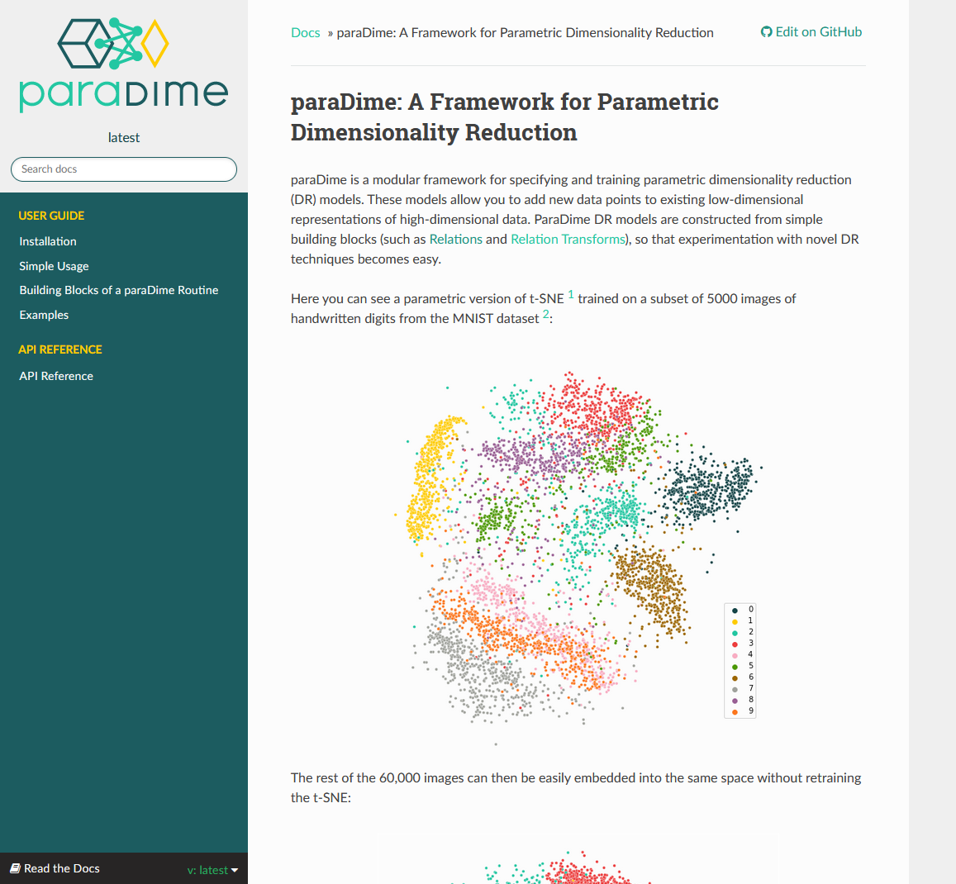
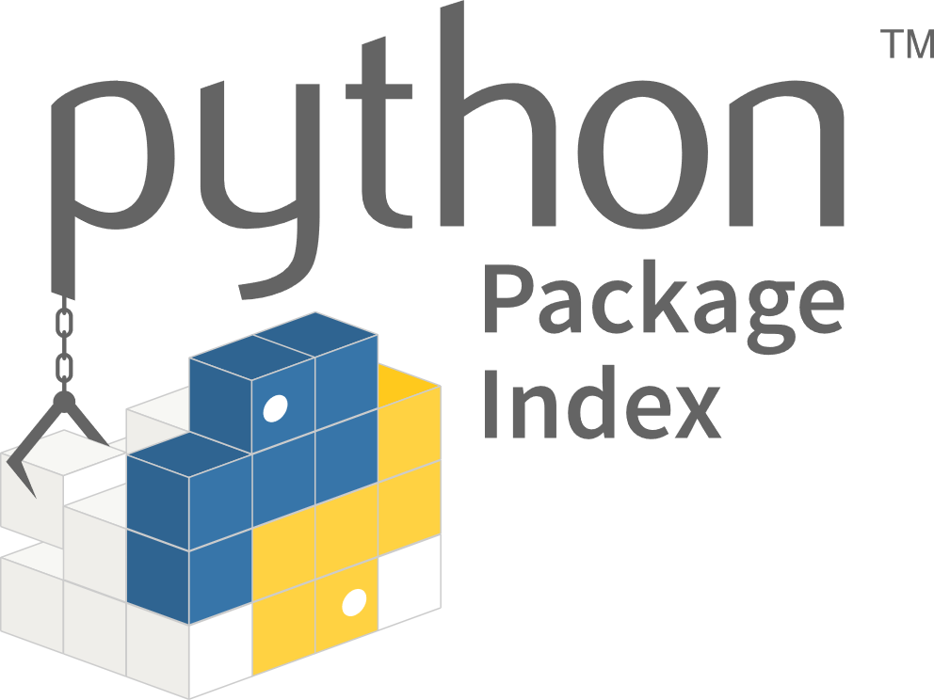
IMPLEMENTATION & DOCUMENTATION
Read the Docs
https://paradime.readthedocs.io/
21
Notes:
Finally, a few words about the implementation and how you can try ParaDime yourself.
We implemented ParaDime using PyTorch. We chose PyTorch over TensorFlow because we found ist the most popular machine learning framework among researchers.
ParaDime is pip-installable and comes with a complete documentation. The documenation also explains a second, object-oriented way of setting up ParaDime routines in Python.
It also contains several detailed examples and links to the paper preprint and the source code.
It should be fairly easy to install and try ParaDime yourself. I would enourrage you to experiment with ParaDime if you‘re interested in dimensionality reduction.

Slide 25
CONCLUSION
Unify
Parameterize
Customize
Share
22
Notes:
So to wrap things up: ParaDime is a framework for parametric dimensionality reduction. It unifies existing techniques, but also allows users to customize them and experiment with new ideas.
To this end ParaDime introduced specifications based on a grammar of dimensionality reduction.
If you want to learn more about ParaDime, this QR code will take you to the paper website that also includes links to the docs and the source code.
Thanks for listening and I hope you‘ll check out ParaDime.

