Slide 1
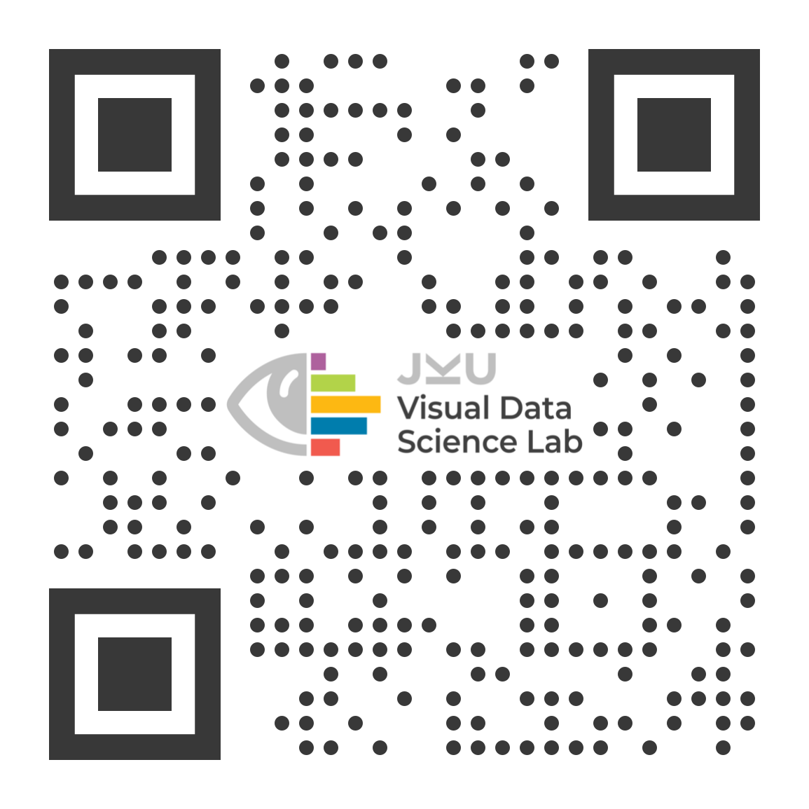
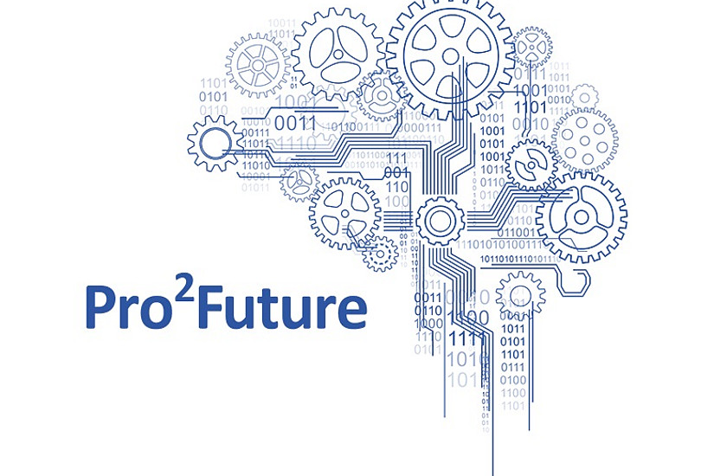
A Process Model for Dashboard Onboarding
EuroVis 2022
V. Dhanoa, C. Walchshofer, A. Hinterreiter, H. Stitz, E. Gröller and M. Streit

Slide 2
1)
2)
Vaishali Dhanoa^{1,2}
Conny Walchshofer^{1,2}
Andreas Hinterreiter²
3)
4)
5)
Holger Stitz³
Eduard Gröller^{4,5}
Marc Streit^{1,2,3}

Slide 3
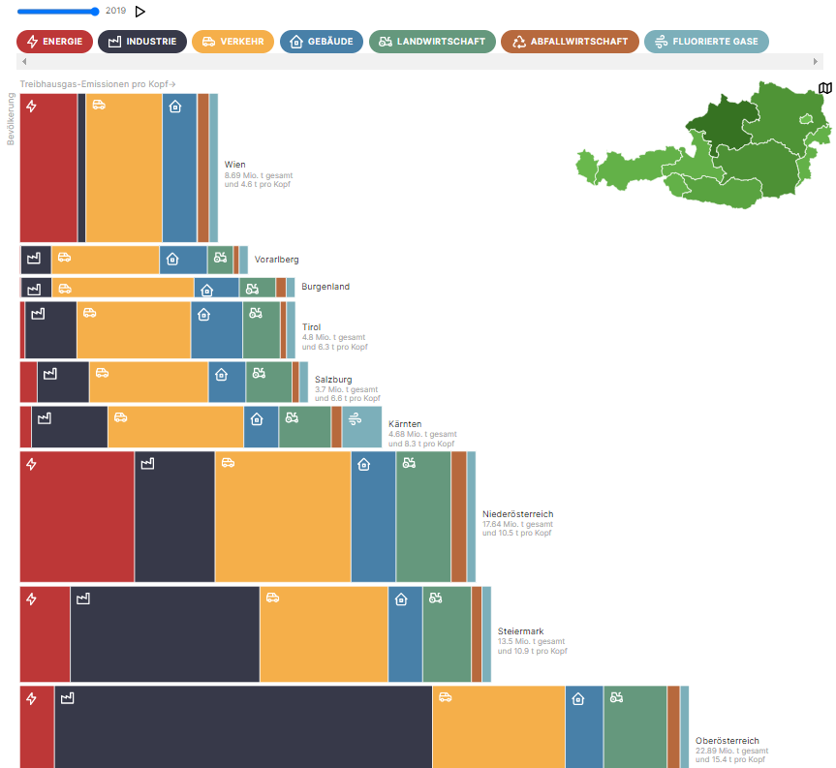
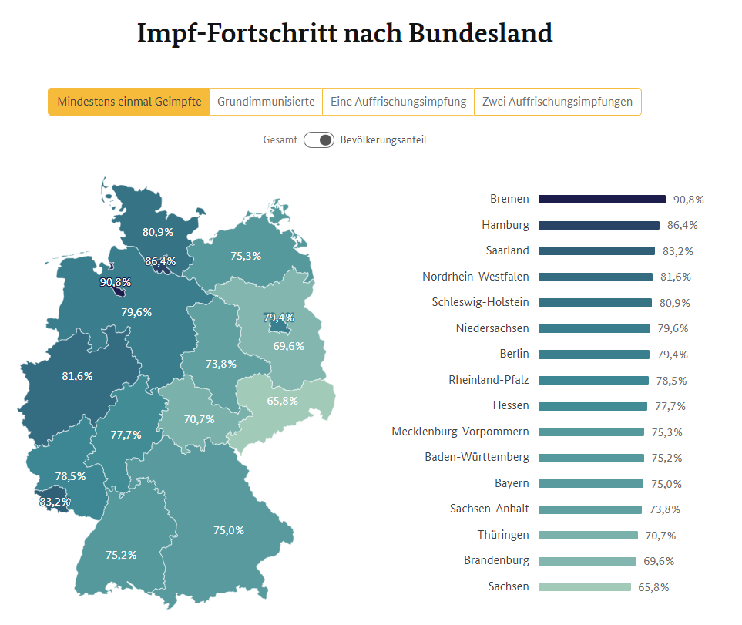
Dashboards
https://impfdashboard.de/
https://klimadashboard.at/
Notes:
So I would like to start my talk by discussing a bit about dashboards. This is the impf dashboard presented earlier in the keynote by moritz stefaner.
And another one is the climate dashboard which has received news coverage in Austria recently.
These are just two examples, but dashboards are being routinely used in other application areas.

Slide 4
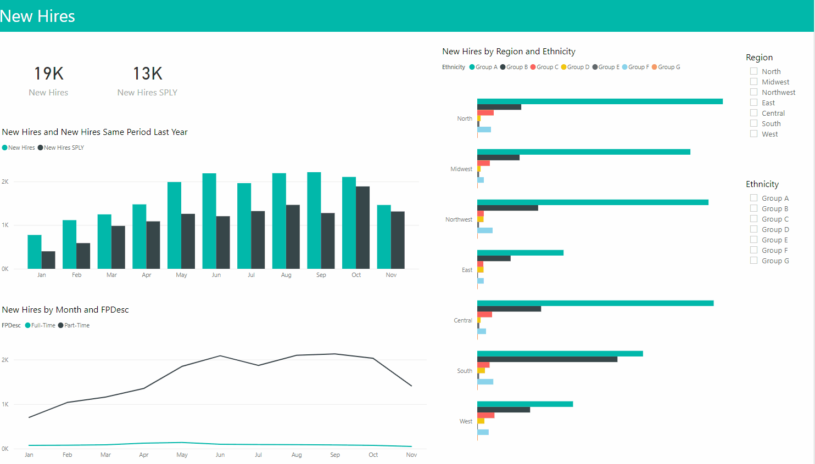
Example Dashboard
Notes:
Here is another example which I will be refering to throughout my presentation. It is a sample dashboard from Power BI which represents new hires from this year and last year. It has 2 key performance indicators for new hires, a bar chart showing distribution of hires over time, a line chart representing full time and part time hires over time , a column chart, showing new hires by region and ethnicity and finally two filters to filter the dashboard by region or ethinicity.

Slide 5
Example Dashboard
Notes:
So now if I also start explaining how these visuals interact, with each other and the effect of filters on them, it gets complicated for people who are not familiar with the dashboard might not understand what's going on. And we came across this problem often during our work with our industrial partners. Therefore, we realized that providing some form of explanation helps which is what we call onboarding.

Slide 6
Guided Tour
Welcome to New Hires
Let’s get started
Notes:
One example of onboarding apart from an oral explanation, could be a guided tour. Such as programming an interface to explain the visuals and in a similar manner their interactions step by step.

Slide 7
Guided Tour
Key Indicators
New Hires this year are 19K, more than last year.
x
Next

Slide 8
Guided Tour
Bar Chart
Shows hires over time for this and last year.
x
Next

Slide 9
Guided Tour
Lines Chart
Shows full and part time hires over time.
x
Next

Slide 10
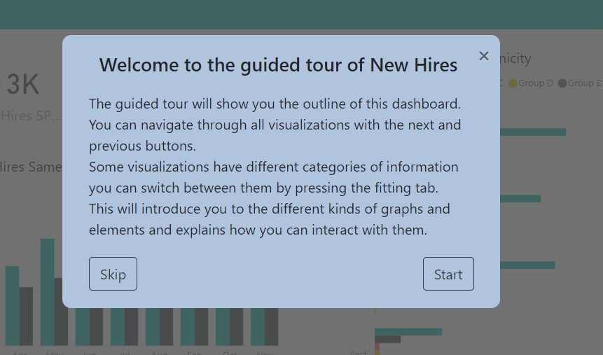
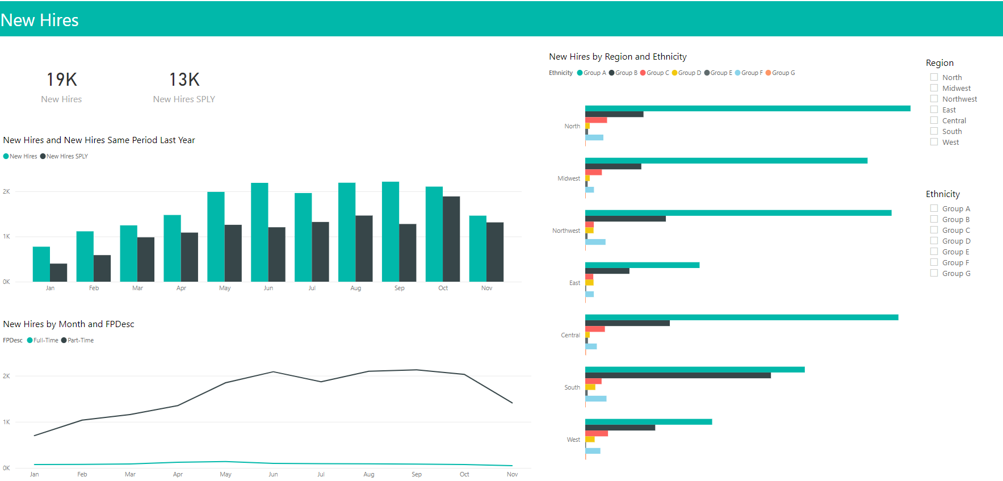
Different Ways of Onboarding
?
Welcome to New Hires!
Here we will talk about some random stuff. Gadsjgasdjg ahsdsjfgjgs fdsagjsdgf jgoewhrj aiyy sufdgewr iwkerkjk thkhaou jwehr ujodaosdh7 wterjh khfsdjfhu hdhfshfd uiwyerkw weroo ..iwyeriyewriy.. Werihiwherwre… weirwireiyiweyiryewiyriweyriweyriewiry. Weriyweriywieryiewr. Hsdkfhsdfyouewjr. Yeyrwyerowreir. Igdsdsahdiahsduasdkasdh wieywyrweuri. Wyeryweorywer. Wieryiewyriweyri. Weirweiryew.
Notes:
We then started collecting different ways of commonly onboarding a dashboard. One is the programmed interface, I just talked about, then we have the oral explanation or presentation, then a video or a documentation describing the contents of onboarding. Or perhaps some other way. To uncover and extract all the common aspects of all these different types of onboarding, we started looking at literature and realized the need of a structured way, such as a model, to think about the onboarding process. And that's exactly I am here to present today. But before we begin, I would like to point out the requirements for such a model.

Slide 11
Requirements for a Process Model
General
Specific
Welcome to New Hires!
Here we will talk about some random stuff. Gadsjgasdjg ahsdsjfgjgs fdsagjsdgf jgoewhrj aiyy sufdgewr iwkerkjk thkhaou jwehr ujodaosdh7 wterjh khfsdjfhu hdhfshfd uiwyerkw weroo ..iwyeriyewriy.. Werihiwherwre… weirwireiyiweyiryewiyriweyriweyriewiry. Weriyweriywieryiewr. Hsdkfhsdfyouewjr. Yeyrwyerowreir. Igdsdsahdiahsduasdkasdh wieywyrweuri. Wyeryweorywer. Wieryiewyriweyri. Weirweiryew.
Actionable
Notes:
We realized that such a model should be general enough to cover all existing onboarding strategies, specific enough so that we can describe a specific model in detail, and actionable which means sticking to it should help us design new onboarding strategies.

Slide 12
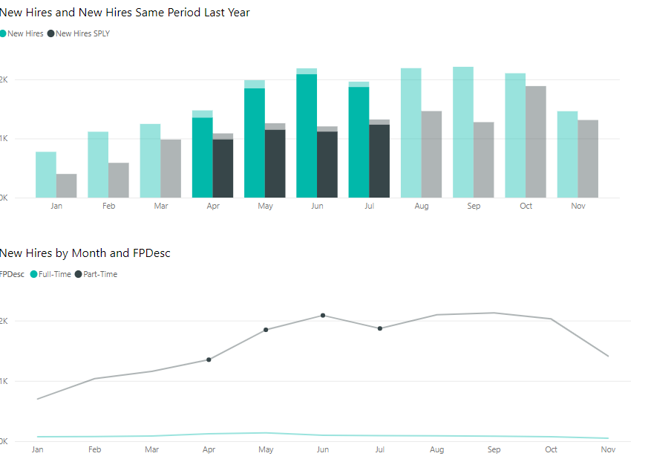
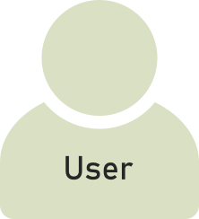
Characterizing the Onboarding Space
HOW
How is dashboard onboarding provided?
Video
Programmed Interface etc.
WHAT
What needs to be onboarded on a dashboard?
Components
Interactions
WHERE
Where is dashboard onboarding provided?
Outside the dashboard
On the dashboard = Interface
WHEN
When is dashboard onboarding used?
Before
During = On-the-fly
Onboard Me
WHO
Who is the user? Which knowledge does the user have?
Dashboard User
Domain expert?
Visual Literate?
WHY
Why is a dashboard onboarding needed?
Due to user’s knowledge?
Complicated visuals?
C. Stoiber et al., (2019). Visualization Onboarding: Learning How to Read and Use Visualizations
Notes:
After listing these requirements, we realized that in order to develop such a model, we also need to characterize the onboarding space for which we plan to build a model. Therefore, we started with the first question: How is the onboarding provided, and as I just talked about it, it could be a video, a programmed interface etc. Then Where is it provided, it could be on the dashboard or outside it. Then who is the user, what is their visual literacy level. Which may also determine what needs to be onboarded, which visuals, interactions etc. And When is it provided, before handing over the dashboard or during the usage of the dashboard. Finally, the most important question: Why is it provided? Because the user is not familiar with interactions or visuals or their interplay? And why is also the driving question behind every other question here, such as why do we decide what to onboard or how to onboard etc..

Slide 13
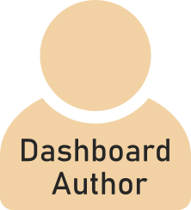
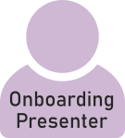
Roles & Interactions in the Onboarding Process
Dashboard
Onboarding System
Notes:
We then started investigating who really decides on this why. And based on the literature, we summarized four main user roles for a given dashboard: 1) Dashboard author --> who creates the dashboard, 2) Onboarding author --> who created the onboarding for the dashboard 3) Onboarding presenter who presents the onboarding to our 4) and final role: the dashboard user.

Slide 14
Roles & Interactions in the Onboarding Process
Dashboard
Onboarding
Onboarding System
Usage
Notes:
We then started defining the interactions among these roles and systems. First we connected the user with the dashboard via the usage loop. In a similar manner, we introduced the onboarding loop between the user and the onboarding system (which is also one of our main contributions --> the introduction of an onboarding loop alongside the dashbaord loop).

Slide 15
Roles & Interactions in the Onboarding Process
Dashboard
Onboarding
Onboarding System
Usage
Notes:
Then we went on to add other connections, such as between dashboard author and the dashboard, and the onboarding author and the dashboard and onboarding and then onboarding presenter and others and so on. And all this made it quite complicated and challenging to describe the influence of every role on the other roles and systems.

Slide 16
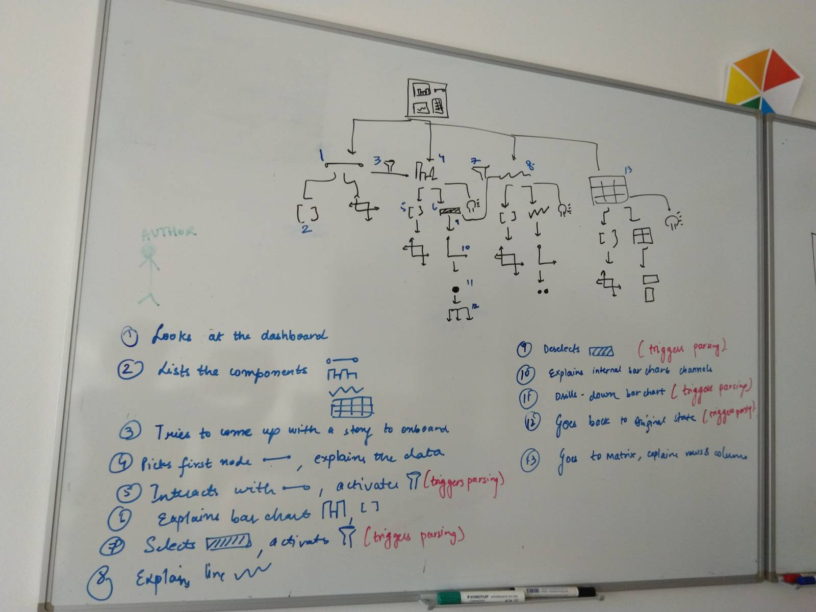
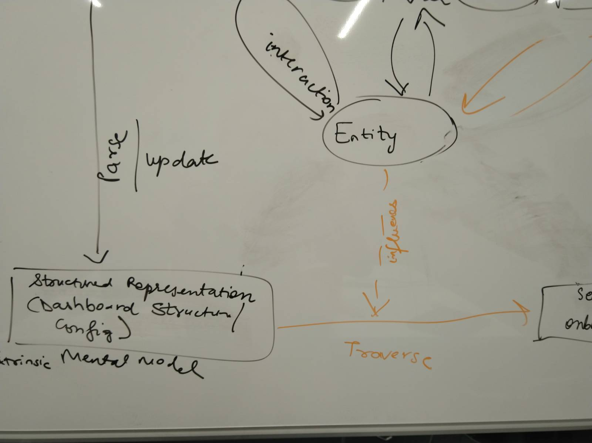
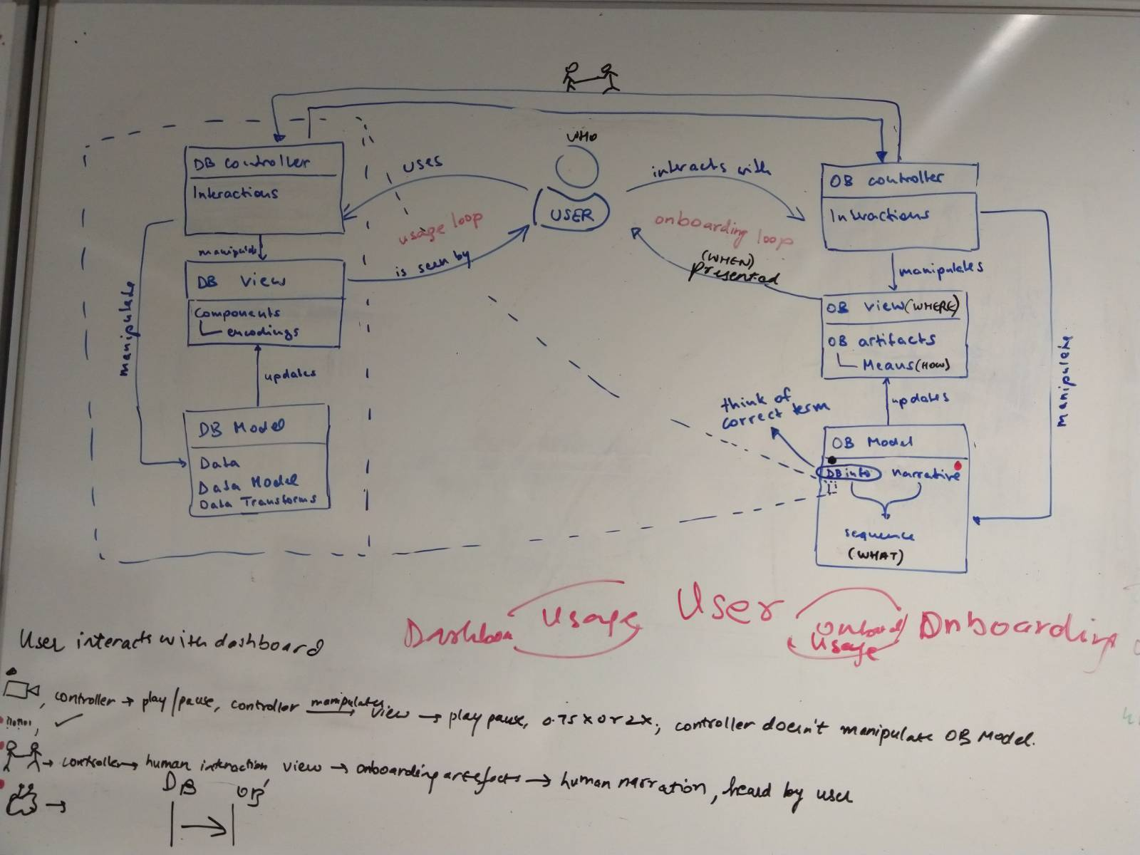
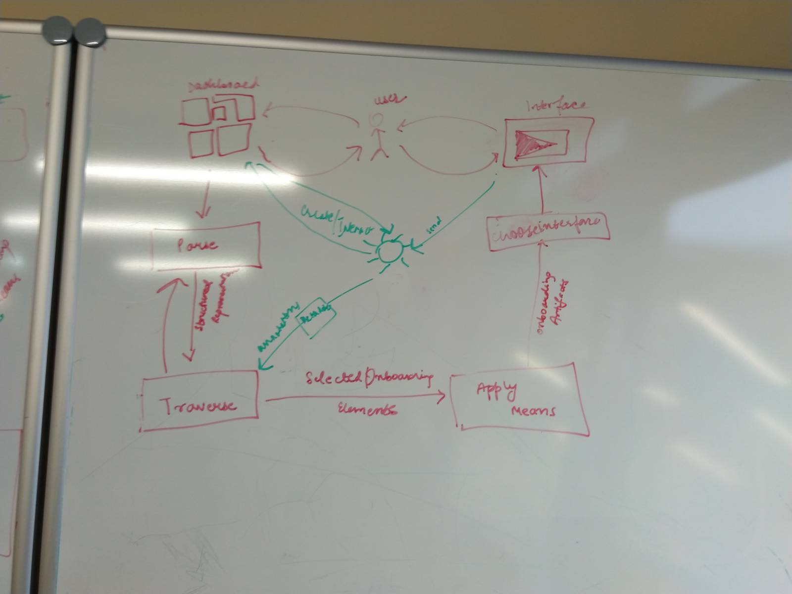
Prototyping the Process Model
Notes:
So we iteratively discussed and created prototypes for describing our process model by testing it against the three requirements: general, specific and actionable.

Slide 17
Onboarding Process Model
Notes:
So finally we arrived on a process model and in very simple form we focus on these two loops with only dashboard user in the center and make the other roles implicit.

Slide 18
Process Model
Usage Loop
Onboarding Loop
Interaction b/w Loops
Examples
Actionable Advice
Future Work
Notes:
So now I will start unpacking these loops and first I will start with the usage loop.

Slide 19
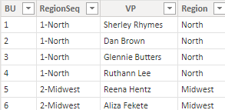
Elements of the Usage Loop
Dashboard
Filter
Mark
Encoding
Axis Field
Channels
Interaction
Data
KPIs
Data Type
Legend
Element
Label
Type
Transformation
Scale
Domain
Bar Chart
Column Chart
Line Chart
Notes:
So for the usage loop, let's discuss the elements which we will require to unpack it. For a given dashboard, we pick out all the elements you can see, such as dashboard, filter, kpis, and various charts. Then for each one of them, we can further list their marks and encodings. Then we specify the interactions which are available on the dashboard, such hover over, or the ones between visuals, such as cross highlighting and filtering. And finally, we talk about the data which comprises of the raw data and the transformations applied on them.

Slide 20
Elements of the Usage Loop
Dashboard Components
Dashboard
Dashboard Interactions
Filter
Data Model
Mark
Encoding
KPIs
Axis Field
Channels
Data Type
Legend
Interaction
Data
Label
Element
Transformation
Bar Chart
Scale
Type
Domain
Column Chart
Line Chart
Notes:
In this step we take these elements and categorize them as: the ones we see and are presented to the user as dashboard components, the interactions as dashboard interactions and finally we call the data and its transformation as data model.

Slide 21
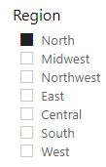
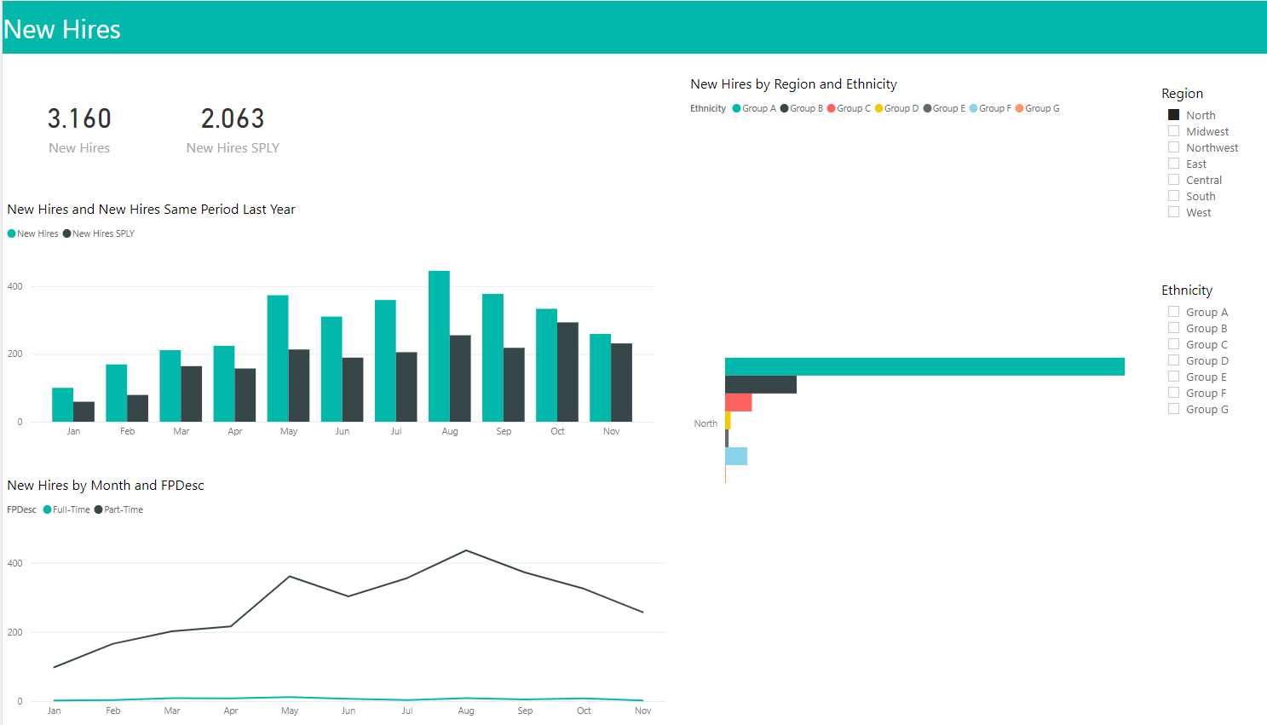
Unpacking the Usage Loop
manipulate
uses
Dashboard Interactions
manipulate
Usage Loop
Data Model
Dashboard Components
presented to
update
Notes:
So now we take these characterized elements and put them together in a manner in order to connect them. So we bring in our user and our dashboard to start the connection process. Let's say the user uses the filter to select a region. To represent this, we add an edge between the user and the dashboard interactions. This interaction automatically updates the underlying data model where now only the information for the region north is available. Then finally, this data model is shown to the user with the help of the updated visuals or components, as shown in the figure.

Slide 22
Usage Loop
manipulate
uses
Dashboard Interactions
manipulate
Usage Loop
Data Model
Dashboard Components
presented to
update
Notes:
Therefore, we arrive at our usage loop.

Slide 23
Process Model
Usage Loop
Onboarding Loop
Interaction b/w Loops
Examples
Actionable Advice
Future Work
Notes:
Now, we move on to the onboarding loop.

Slide 24
Elements of the Onboarding Loop
informs
manipulate
Dashboard Interactions
uses
manipulate
Usage Loop
Onboarding Content
Data Model
Dashboard Components
presented to
update
Notes:
So in order to unpack the onboarding loop, we also need to specify the elements of this loop. In order to do so, we would need our usage loop as it serves as the basis of what content needs to be onboarded to the user.

Slide 25
Unpacking the Onboarding Loop
informs
Dashboard
Data
KPIs
Filter
Dashboard
Onboarding Content
Interaction
Usage
Type
Bar Chart
Column Chart
Line Chart
Notes:
So now that we know what the usage loop is, I just collapsed it to pay attention to the onboarding system and its loop. Okay so from our dashboard we can extract a list of components which we could potentially show to the user.

Slide 26
Unpacking the Onboarding Loop
informs
Dashboard
Data
Filter
Interaction
Type
Dashboard
Usage
Onboarding Content
KPIs
Dashboard Info Narrative
Column Chart
Bar Chart
Line Chart
Notes:
However, in some cases, you may need to reorder them and add or remove a few details before showing them to the user. This is referred to as the narrative, which when applied to the components results in a sequence you wish to onboard to the user.

Slide 27
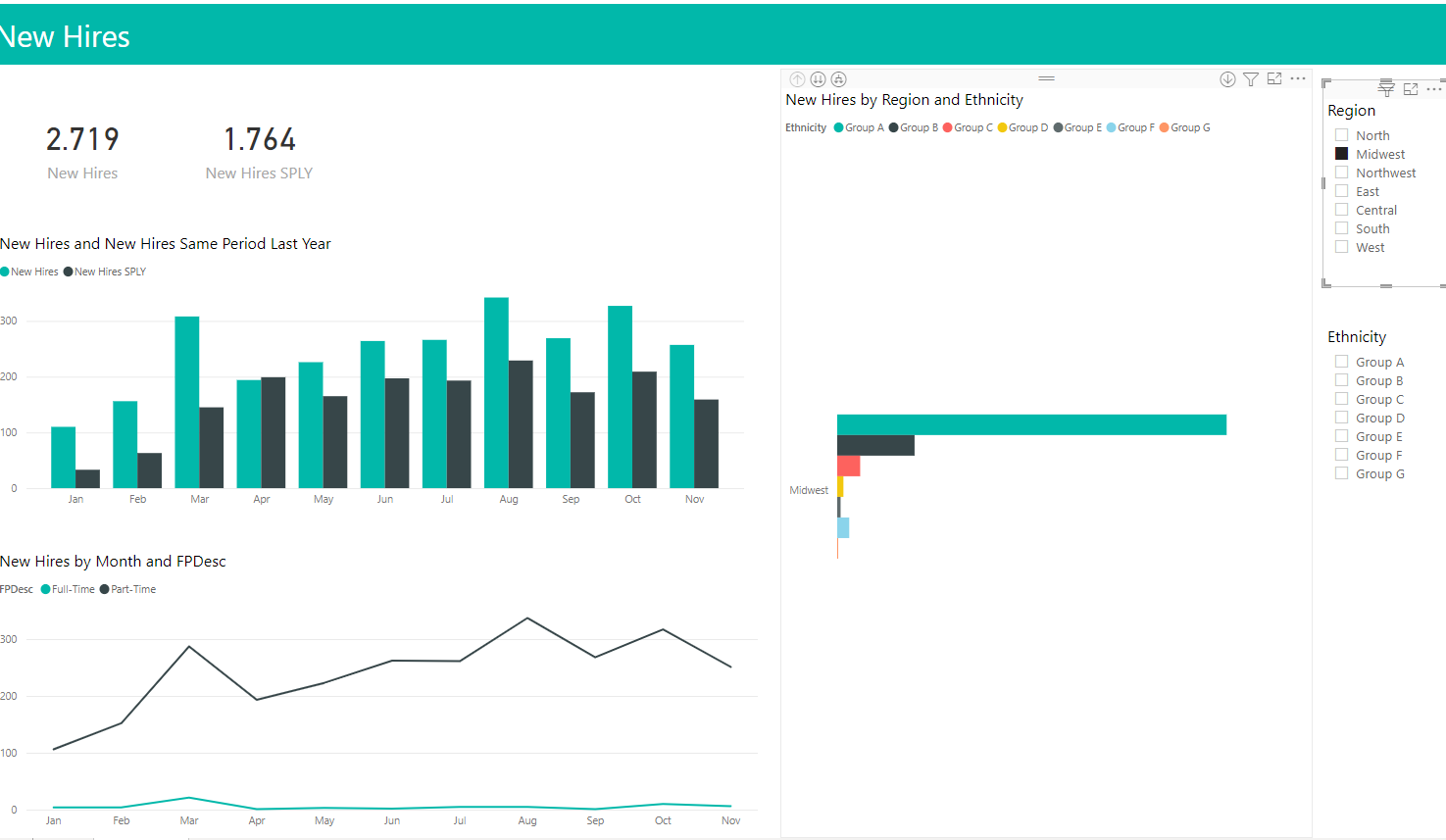
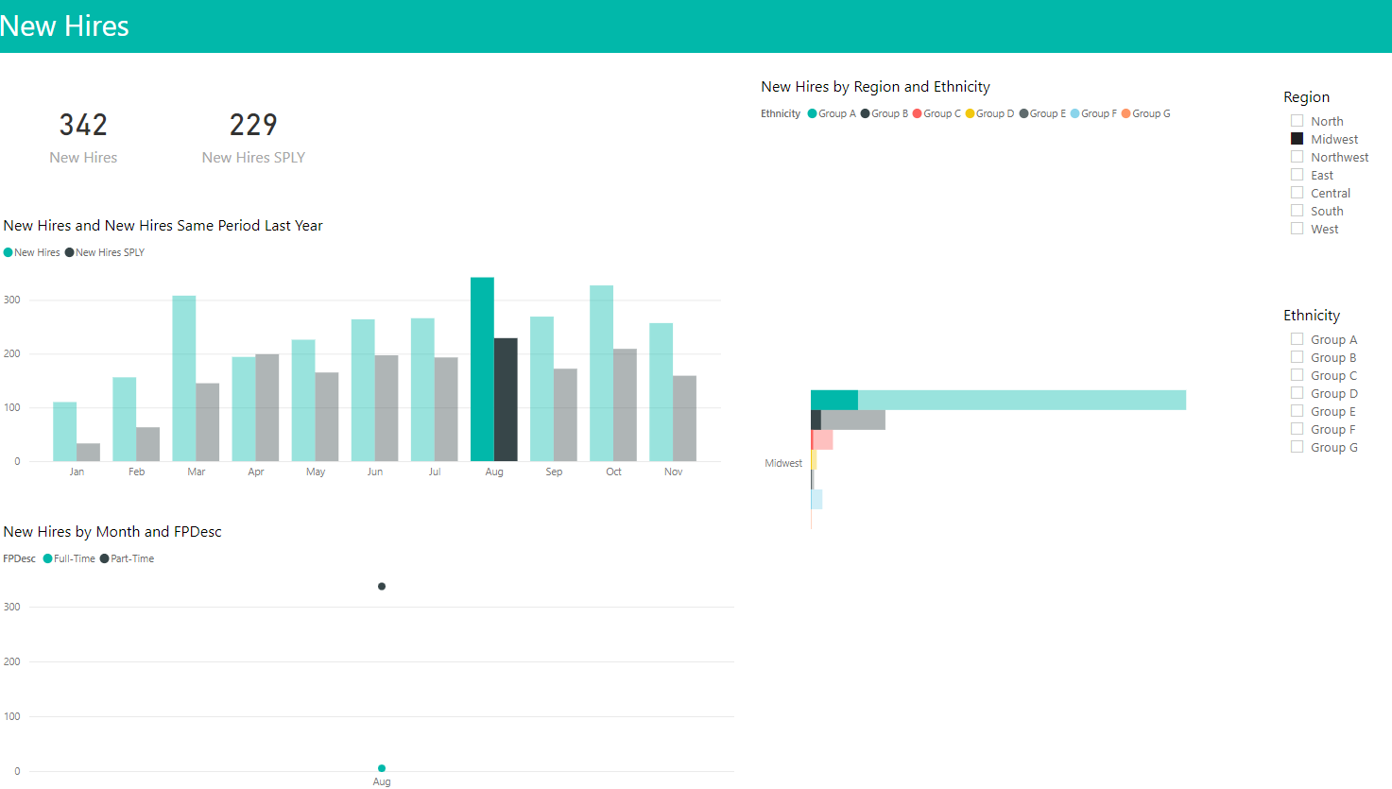
Unpacking the Onboarding Loop
informs
Dashboard
Usage
Onboarding Content
Onboarding Artifacts
presented to
(how) apply means
Notes:
Now we move on to "how" you will present this sequence to the user. So typical examples such as video, porgrammed interface etc can be used which result in onboarding artifacts which are then presented to the user. These artifacts can be oral explanation in case of a presentation, textual explanation in case of documentation and video sequences in case of video onboarding.

Slide 28
Unpacking the Onboarding Loop
informs
uses
Onboarding Interactions
manipulate
Dashboard
Usage
Onboarding Loop
Onboarding Content
manipulate
Onboarding Artifacts
presented to
apply means
Notes:
Then finally, depending on the means, the user can also interact with the onboarding system via the onboarding interactions., which can be play/pause in case of video onboarding which can manipulate or navigate the video sequences, and clicking on the next/previous steps in case of a programmed interface which may manipulate the underlying onboarding content, depending on the way it is programmed.

Slide 29
Onboarding Loop
informs
uses
Onboarding Interactions
manipulate
Dashboard
Usage
Onboarding Loop
Onboarding Content
manipulate
Onboarding Artifacts
presented to
apply means
Notes:
Therefore, we obtain our onboarding loop.

Slide 30
Process Model
Usage Loop
Onboarding Loop
Interaction b/w Loops
Examples
Actionable Advice
Future Work
Notes:
Now, I will talk about the interaction between the usage and the onboarding loop.

Slide 31
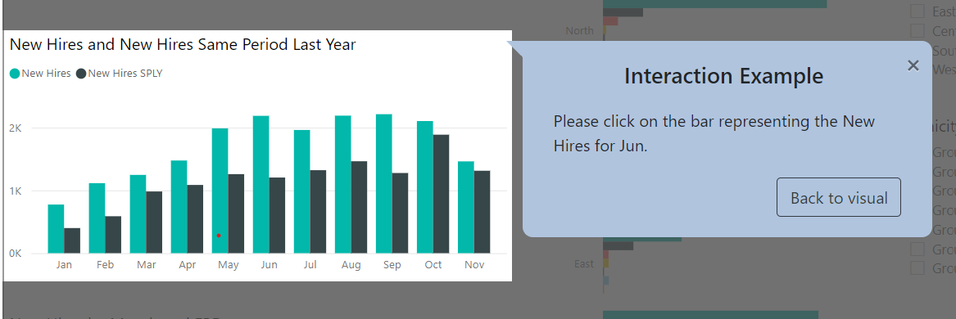
Interaction between the Dashboard & Onboarding Loop
triggers
Dashboard
Onboarding
Onboarding System
Usage
Notes:
So in some cases these loops are not entirely independent. For example, if you have a programmed interface and if you click on a bar which modified the line chart, your onboarding may change accordingly. Therefore, we add a double sided arrow to represent that an onboarding interaction may
"trigger" a change in the dashboard and vice versa.

Slide 32
Process Model
Usage Loop
Onboarding Loop
Interaction b/w Loops
Examples
Actionable Advice
Future Work
Notes:
Now I will talk about two examples to show you our process model can be used to map an existing onboarding strategy, such as a video and describe an onboarding with a human presenter.

Slide 33
Example: Video
Dashboard
Data
Filter
Interaction
Type
KPIs
Onboarding Content
Onboarding Artifacts
Onboarding Interactions
Bar Chart
Line Chart
Notes:
So our first example is that of a video. Let us consider this dashboard again, the first step to creating a video would be to extract the components of the dashboard for the content of the video. Secondly, you will record a video of yourself explaining these components in a specific sequence which will result in video sequences which we refer to as onboarding artifacts. Then you will finally provide the video with play pause interaction controls to the user.

Slide 34
Example: Video
informs
Onboarding Interactions
uses
update
Dashboard
Onboarding Loop
Onboarding Content
navigate
apply means
Onboarding Artifacts
presented to
Notes:
So now we take these elements and again try to add the connections we described earlier in our process model. So the first one is the dashboard which was used to inform the onboarding content of making this video tutorial. Then you video recorded yourself to create video sequences which were then presented to the user. Who could then use the play pause interactions to navigate through these sequences. And as these interactions are limited, they cannot manipulate the underlying content, hence the greyed out edge. Also, as the user cannot interact with the dashboard in the video, the usage loop is missing and the trigger edge is missing too.
And this is how the process model for a video onboarding looks like.

Slide 35
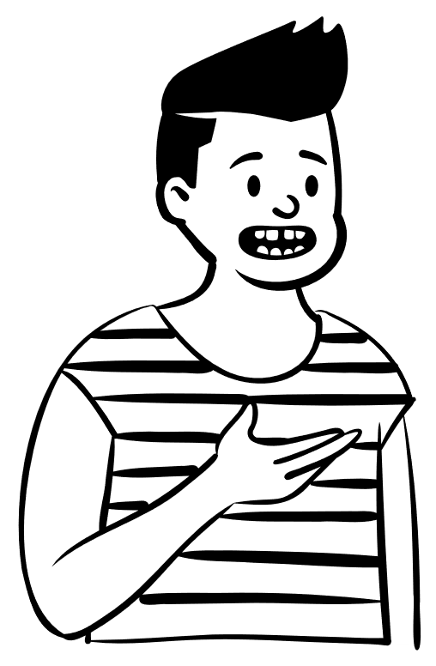
Example: Human Presenter
Dashboard
Data
Filter
Interaction
Type
KPIs
Onboarding Content
Onboarding Artifacts
Onboarding Interactions
Bar Chart
Line Chart
Notes:
Now I will talk about the onboarding with a human presenter. So again for simplicity, let's talk about the same dashboard. Similar to the video, you will extract the components you would like to present. Then instead of a video, you will do a live presentation of the content and use oral explanations and perhaps gestures as artifacts to present the onboarding to the user. The user can then ask questions as means of interaction with you.

Slide 36
Example: Human Presenter
trigger
informs
Onboarding Interactions
uses
update
Onboarding Loop
Onboarding Content
Dashboard
prompt
Usage
apply means
Onboarding Artifacts
presented to
Notes:
So now let's look at its model, again the dashboard was used to inform the onboarding content. Then you present it via oral explanations to the user who then could ask questions. These interactions, can in some cases either trigger a change in the dashboard with you adjusting a filter to explain something, thereby updating the underlying content or may prompt you to rephrase what you just explained causing a change in the artifacts. And that's how it looks like for the human presenterIn the paper, we discuss how we used our model to actually onboard a user on a dashboard and further discuss 4 more examples which we can describe using our process model.

Slide 37
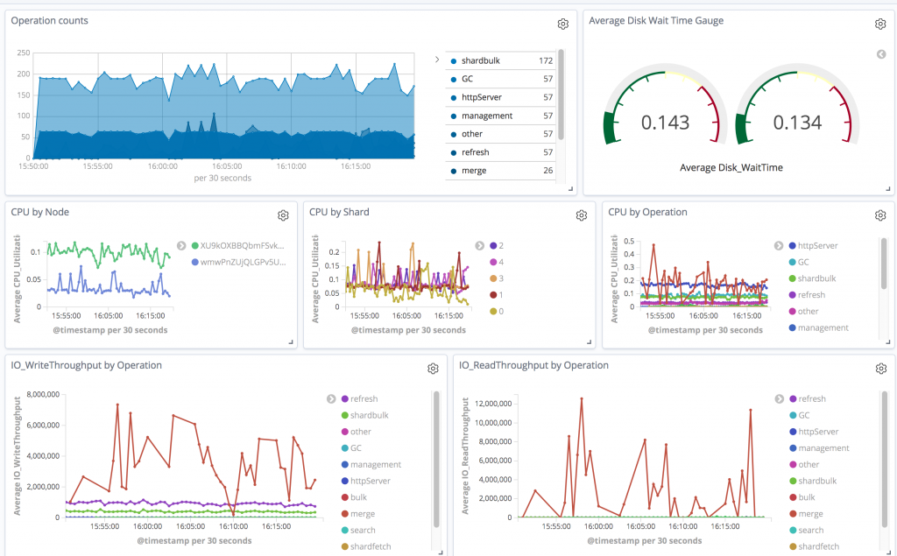
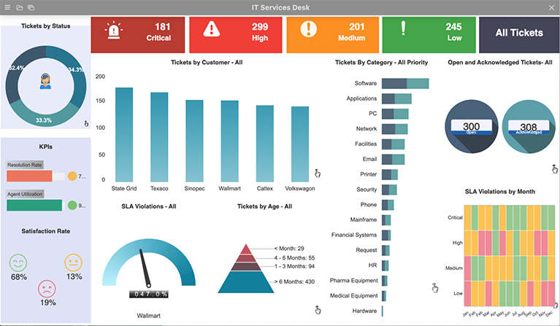
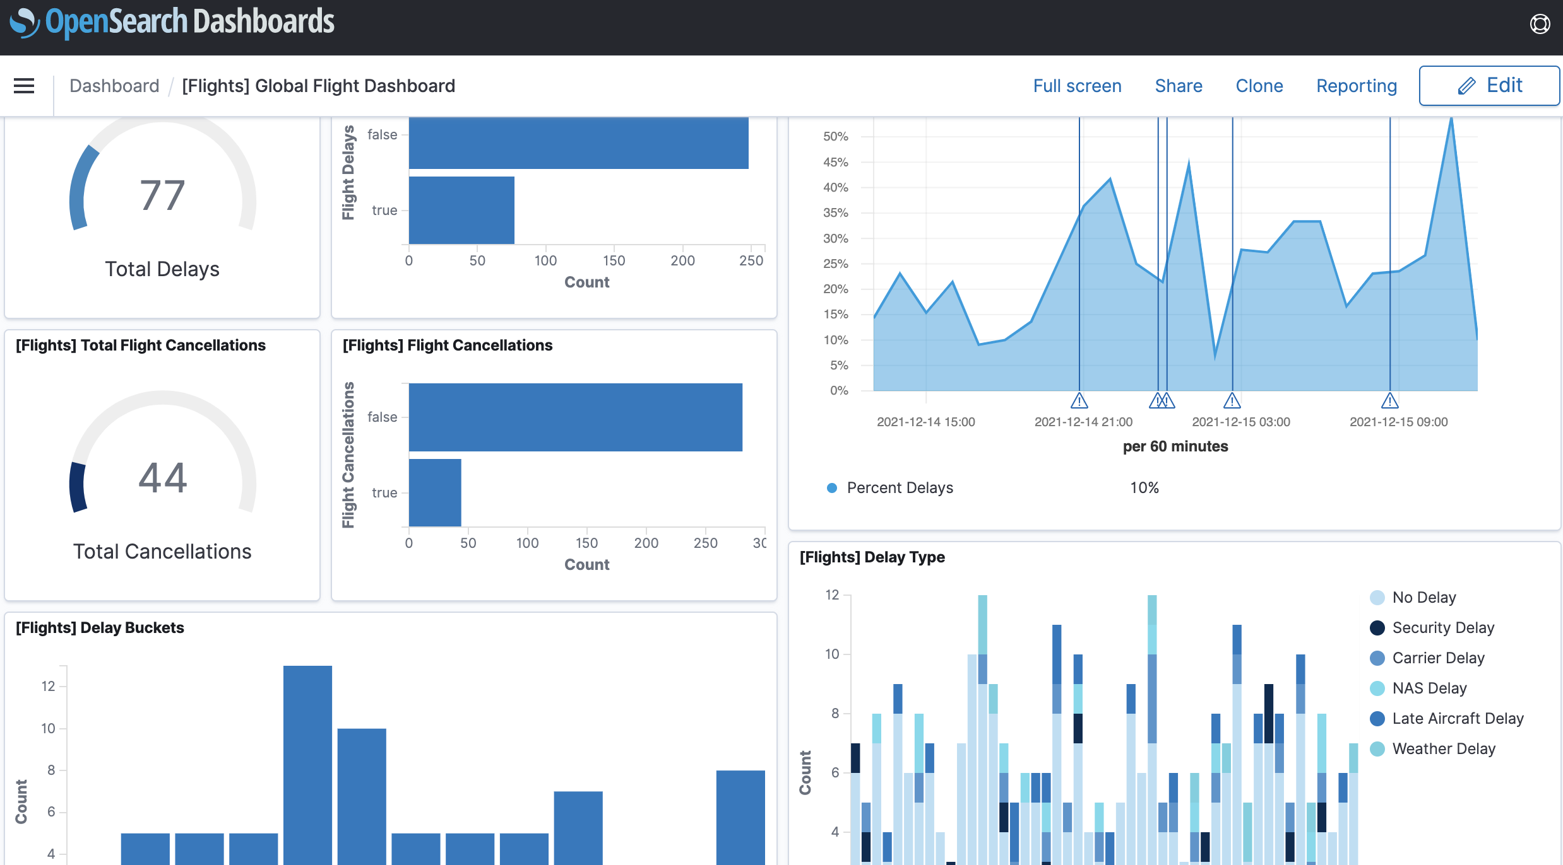
Process Model
Usage Loop
Onboarding Loop
Interaction b/w Loops
Examples
Actionable Advice
Future Work
Notes:
Now, I would like to give you some actionable advice or takeaways which you can use while designing an onboarding strategy for your user.

Slide 38
Actionable Advice
informs
Dashboard
Data
uses
Onboarding Interactions
manipulate
Filter
Interaction
Type
Dashboard
Usage
Onboarding Loop
Onboarding Content
KPIs
manipulate
Column Chart
Onboarding Artifacts
Bar Chart
presented to
apply means
Line Chart
Notes:
So firstly, the onboarding content lets you specify what you could onboard to your user. In the paper we describe it in much more detail on how you can author your content. Then based on the content, the model provides you the next step of how to present it, and as the model keeps the user in the center, you can plan the amount of interaction you would like to have during the onboarding and how it can influence your decision of onboarding. Additionally, after you have delivered your onboarding, you can also evaluate it using our process model by tracing every connection through the model and improving on your strategy where needed.

Slide 39
Actionable Advice: Implementation
informs
Model View Controller
uses
Onboarding Interactions
manipulate
Dashboard
Usage
Onboarding Loop
Onboarding Content
manipulate
Onboarding Artifacts
presented to
apply means
Notes:
Then we have some advice on how to implement one of the ways of onboarding someone using our process model. As the model resembles the model view control pattern, it becomes easier to implement an onboarding strategy which divide the related program logic into three interconnected elements using our model. I will briefly talk about it in our future work.

Slide 40
Process Model
Usage Loop
Onboarding Loop
Interaction b/w Loops
Examples
Actionable Advice
Future Work
Notes:
Now onto the future work

Slide 41
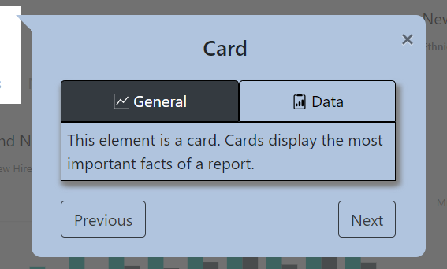
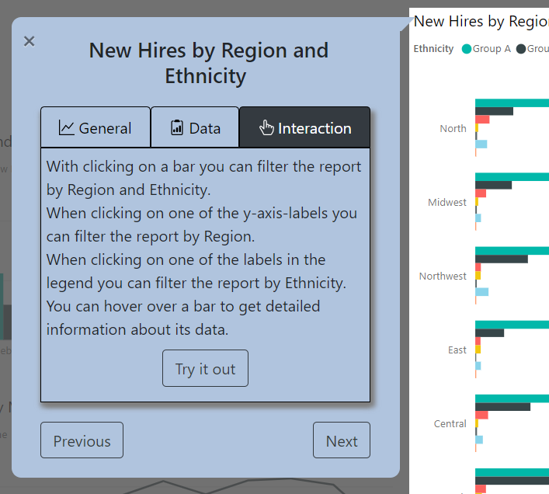
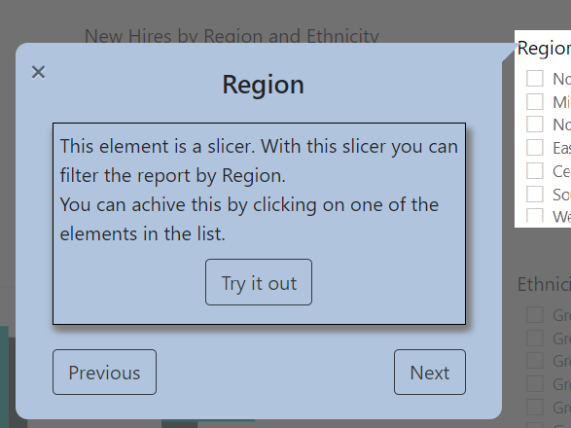
Future Work
Notes:
For the future work, we are already in the process of implementing a programmed interface based on our model, which automatically extracts the components from an exemplary dashboard and then creates a pre-defined sequence which is presented through textual explanation to the user. Our next step in to involve user's characteristics and interactively adapt our onboarding strategy.

Slide 42
Conclusion
Dashboard
Usage
Onboarding
Onboarding System
Notes:
Finally I conclude my talk with a short recap of a simplified form of our model

Slide 43
Conclusion
manipulate
uses
manipulate
Dashboard Interactions
Onboarding Interactions
Usage Loop
Onboarding Loop
Data Model
manipulate
manipulate
Onboarding Content
Dashboard Components
Onboarding Artifacts
update
presented to
update
Link to the paper: https://osf.io/gux9w/
Notes:
and how we expanded it during the talk. Thank you. This is the process model link to the paper and QR code for the same.

