Slide 1
Coral Web-based Visual Analysis Tool for Creating and Characterizing Cohorts
Patrick Adelberger, Klaus Eckelt, Markus J. Bauer,
Marc Streit, Christian Haslinger, and Thomas Zichner
https://jku-vds-lab.at/biovis22-adelberger
patrick.adelberger@jku.at

Slide 2
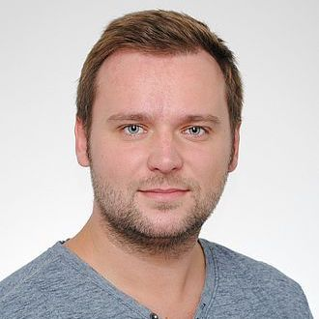
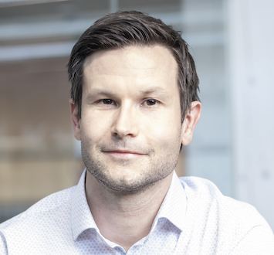
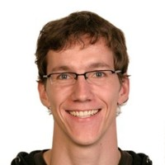
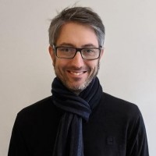
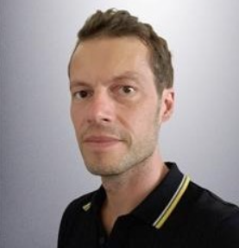
Team
Patrick Adelberger
Klaus Eckelt
Marc Streit
Thomas Zichner
Markus Bauer
Christian Haslinger

Slide 3
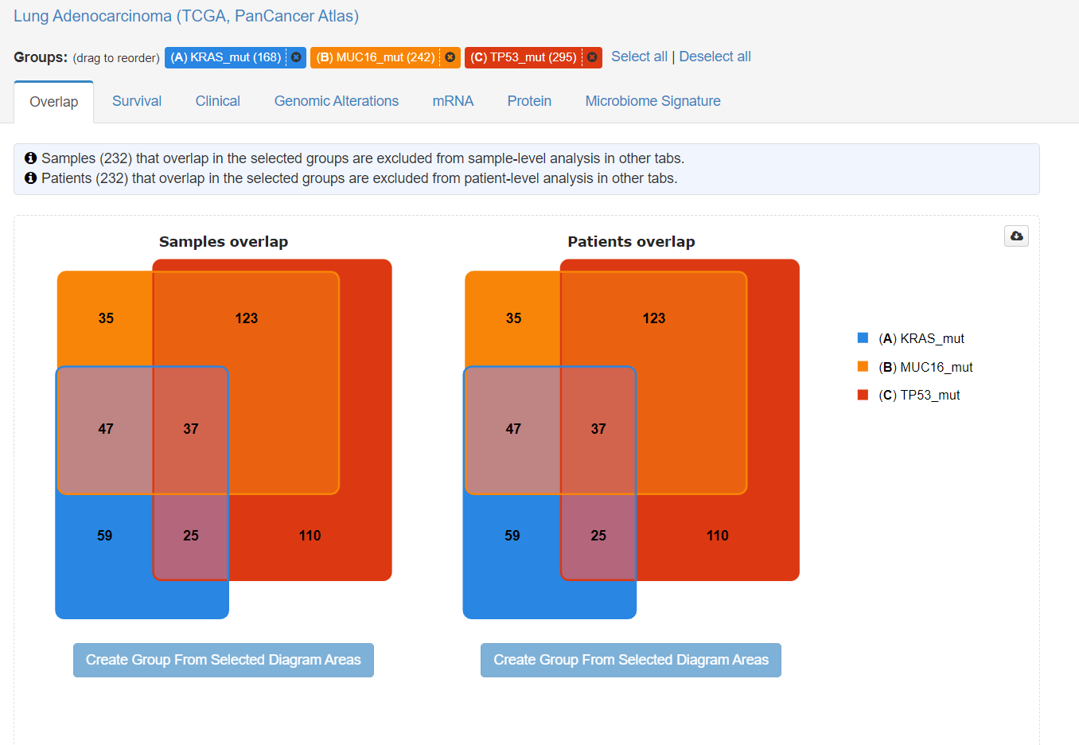
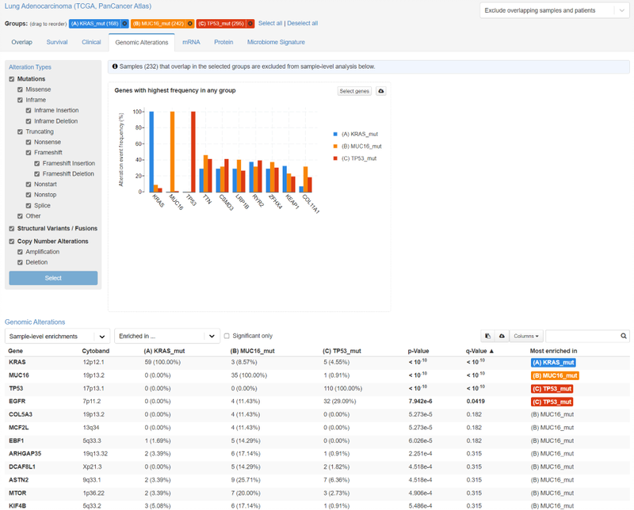
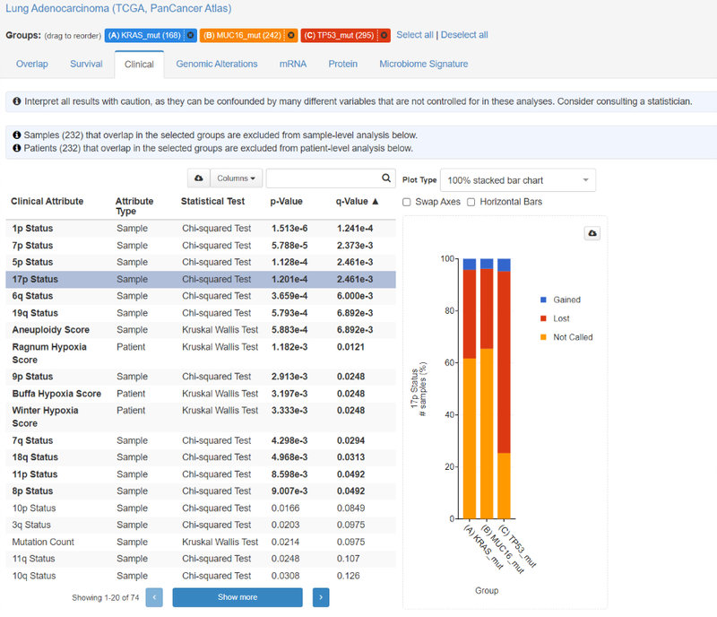
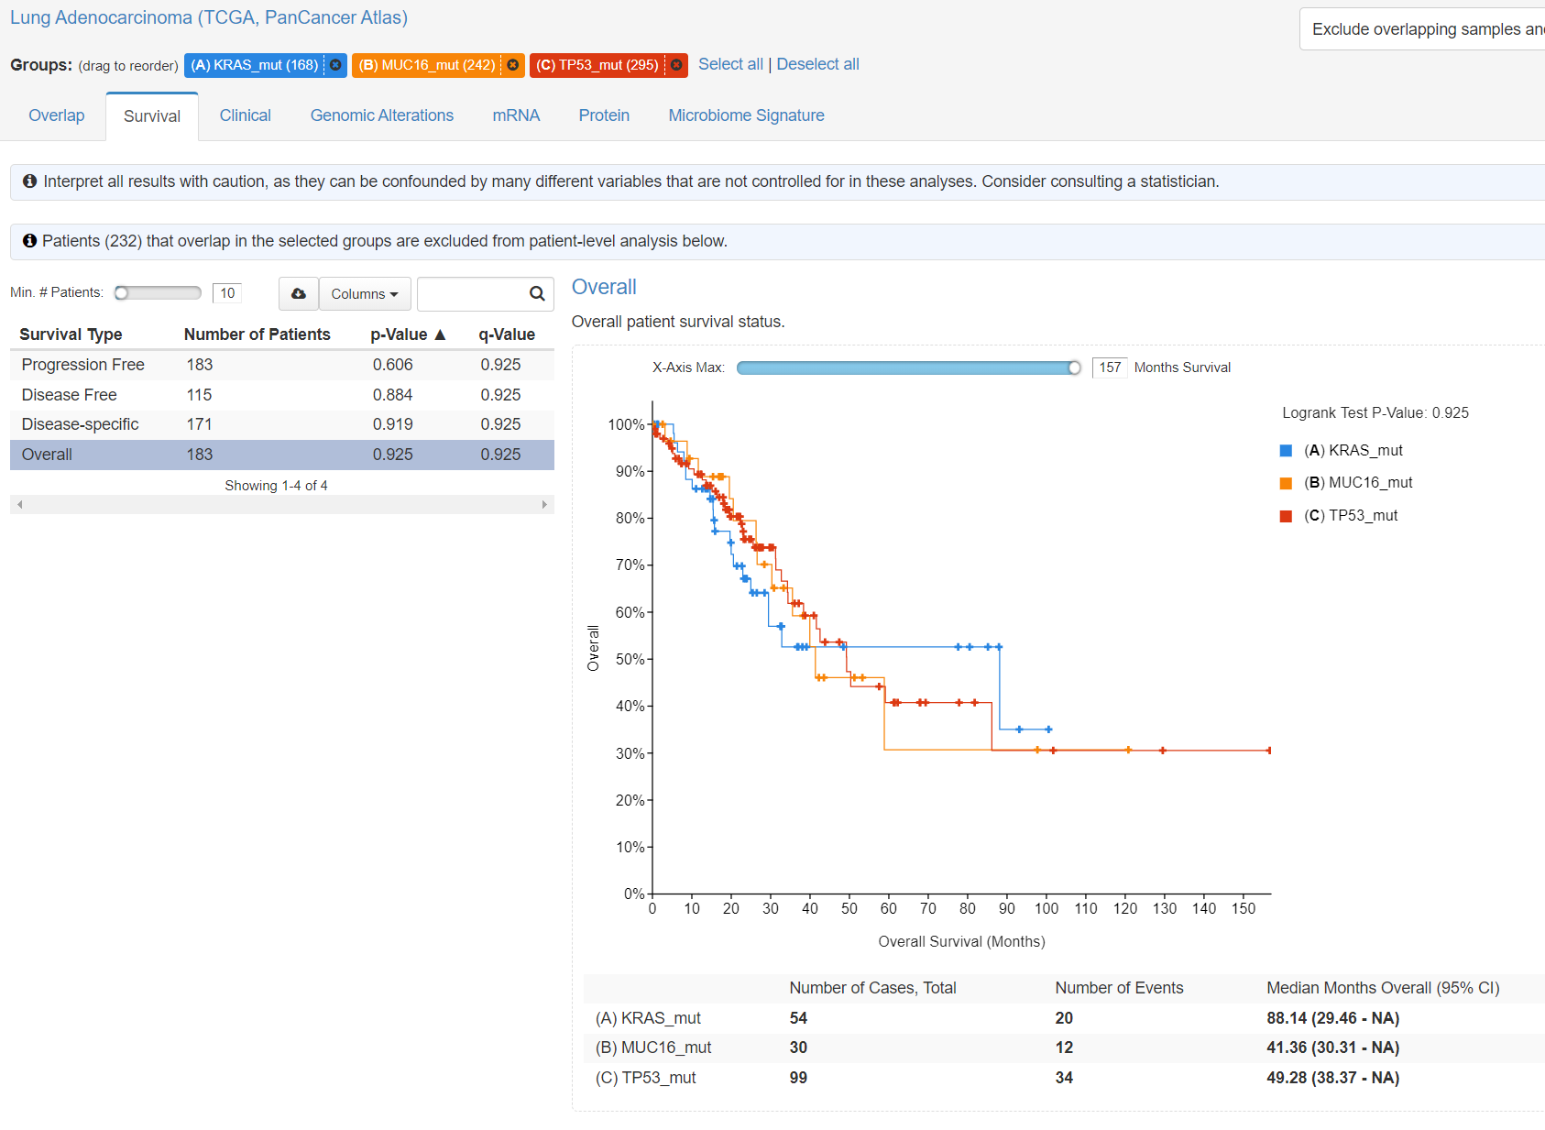
Motivation

Slide 4
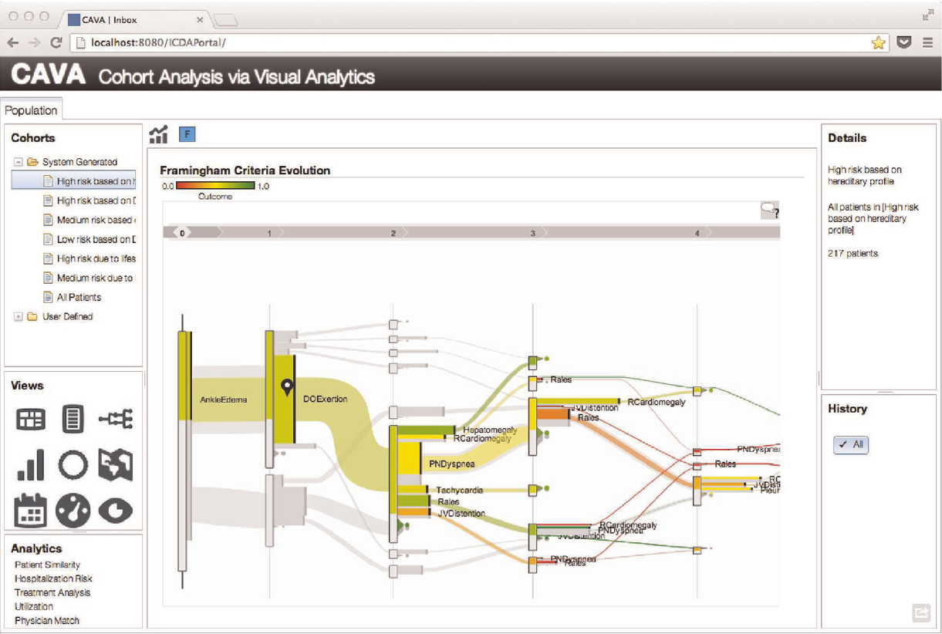
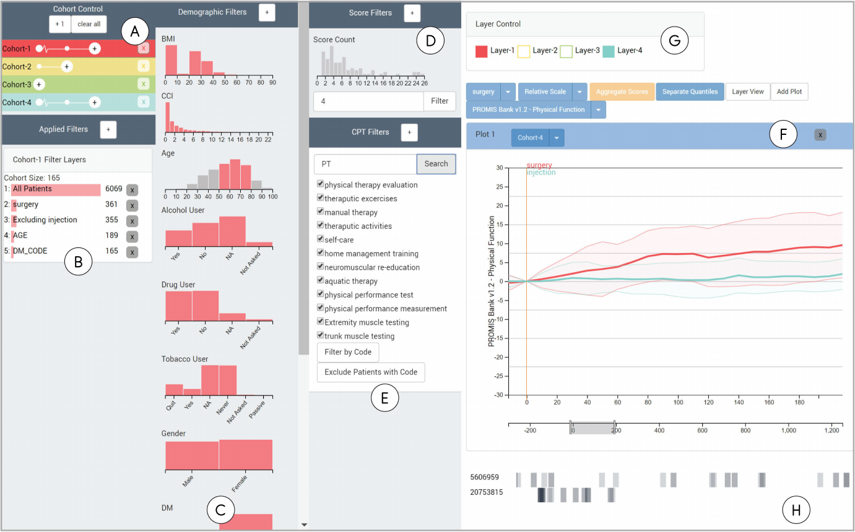
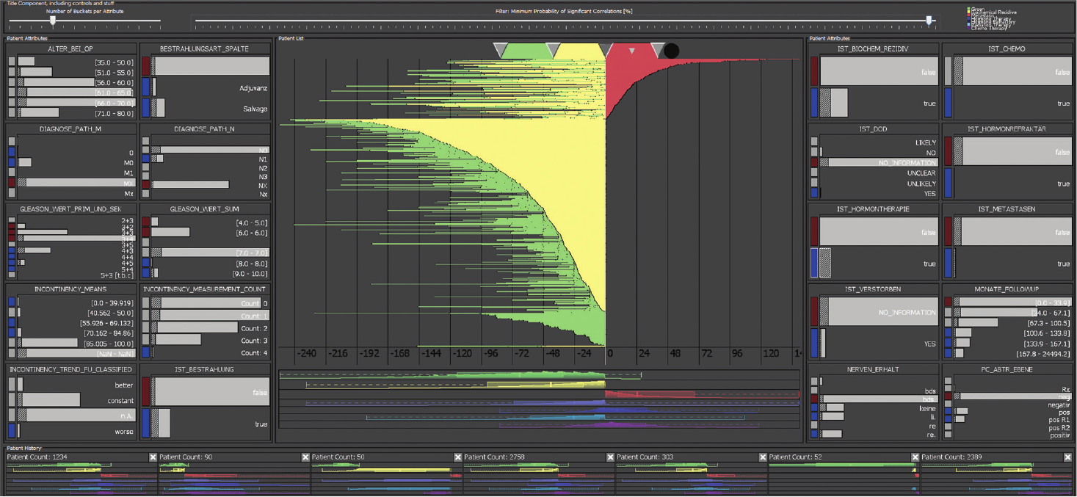
Motivation

Slide 5
Motivation
Rogers, Jen, et al. Composer—visual cohort analysis of patient outcomes. Applied Clinical Informatics 10.02 (2019): 278-285.
Zhang, Zhiyuan, David Gotz, and Adam Perer. Iterative cohort analysis and exploration. Information Visualization 14.4 (2015): 289-307.
Bernard, Jürgen, et al. A visual-interactive system for prostate cancer cohort analysis. IEEE computer graphics and applications 35.3 (2015): 44-55.
Cerami, Ethan, et al. The cBio cancer genomics portal: an open platform for exploring multidimensional cancer genomics data. Cancer discovery 2.5 (2012): 401-404
Gao, Jianjiong, et al. Integrative analysis of complex cancer genomics and clinical profiles using the cBioPortal. Science signaling 6.269 (2013): pl1..

Slide 6
coral.jku-vds-lab.at

Slide 7
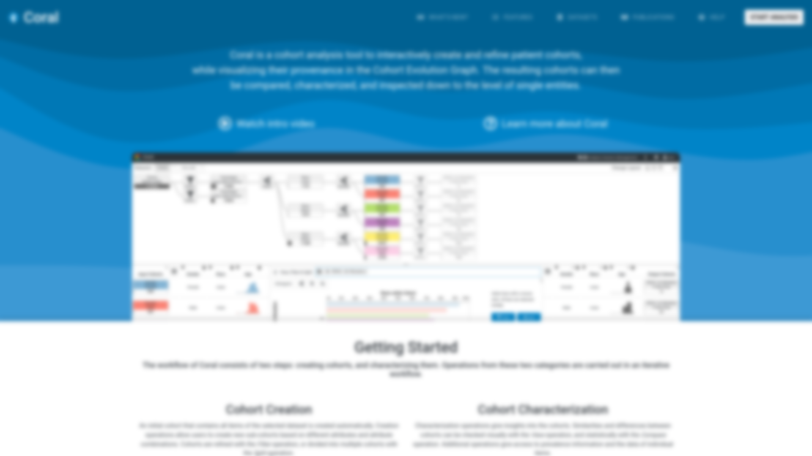
coral.jku-vds-lab.at

Slide 8
Datasets
https://www.aacr.org/professionals/research/aacr-project-genie/
https://cancergenome.nih.gov
https://portals.broadinstitute.org/ccle

Slide 9
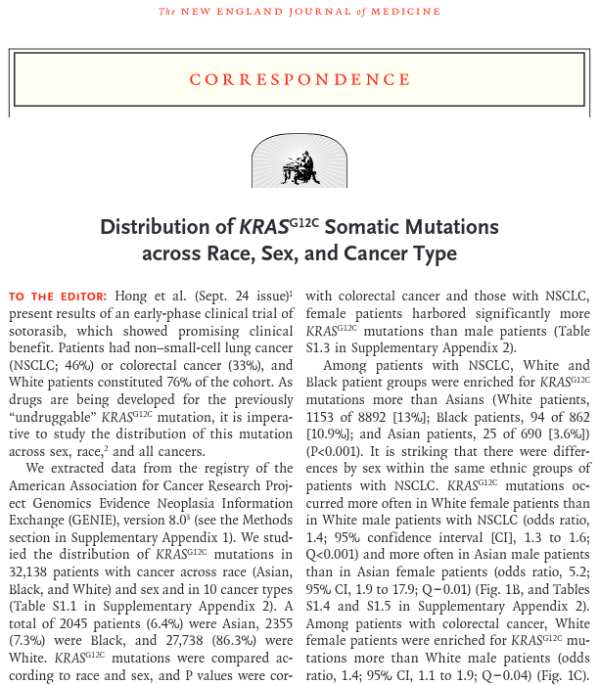
Use Case with GENIE Dataset
Nassar, Amin H., et al. Distribution of KRAS G12C somatic mutations across race, sex, and cancer type. New England Journal of Medicine 384.2 (2021): 185-187.

Slide 12
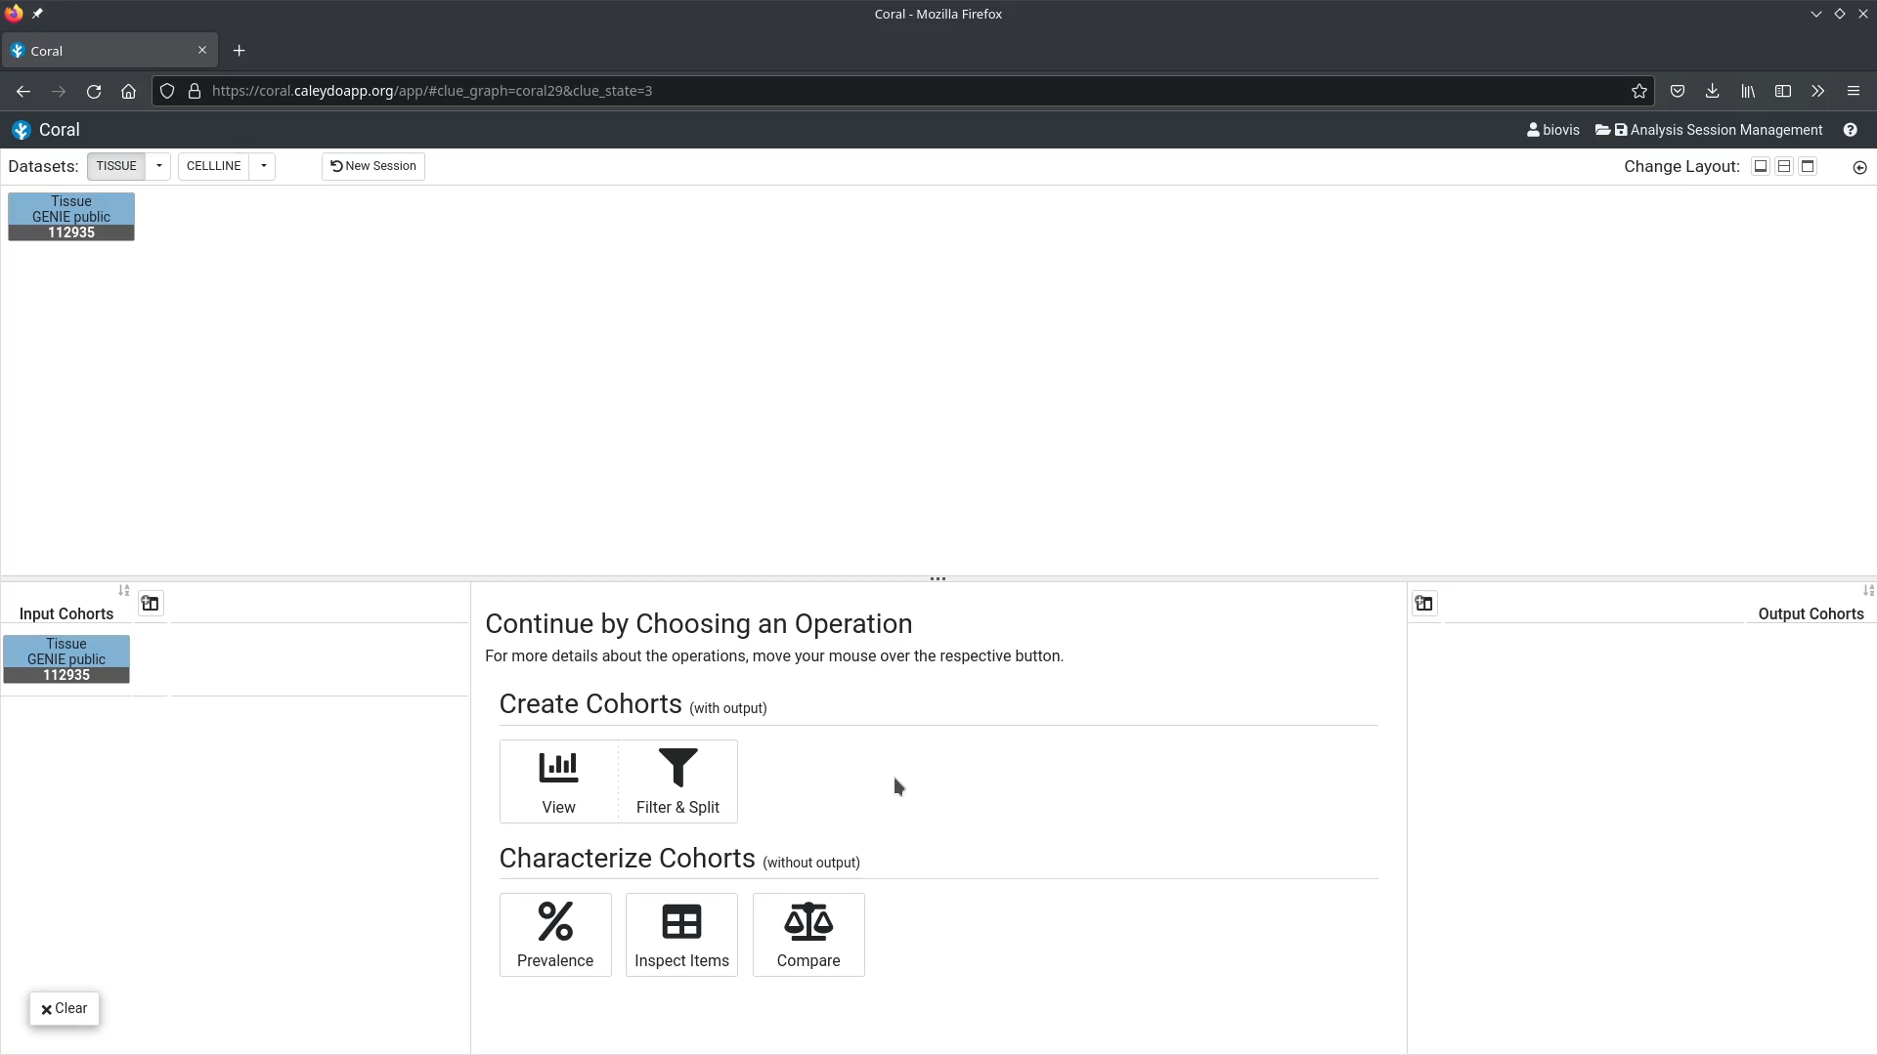

Slide 13
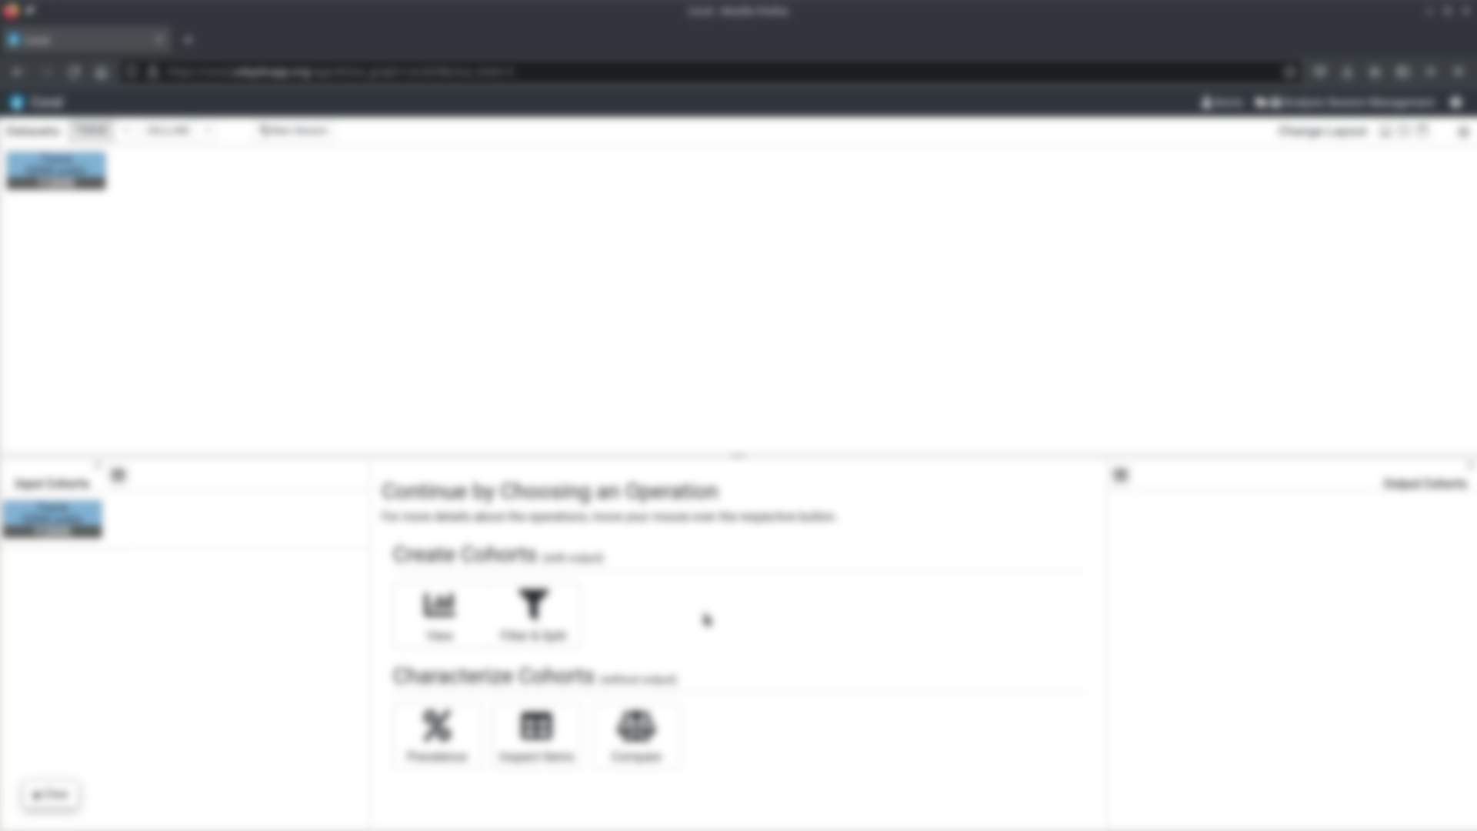

Slide 29
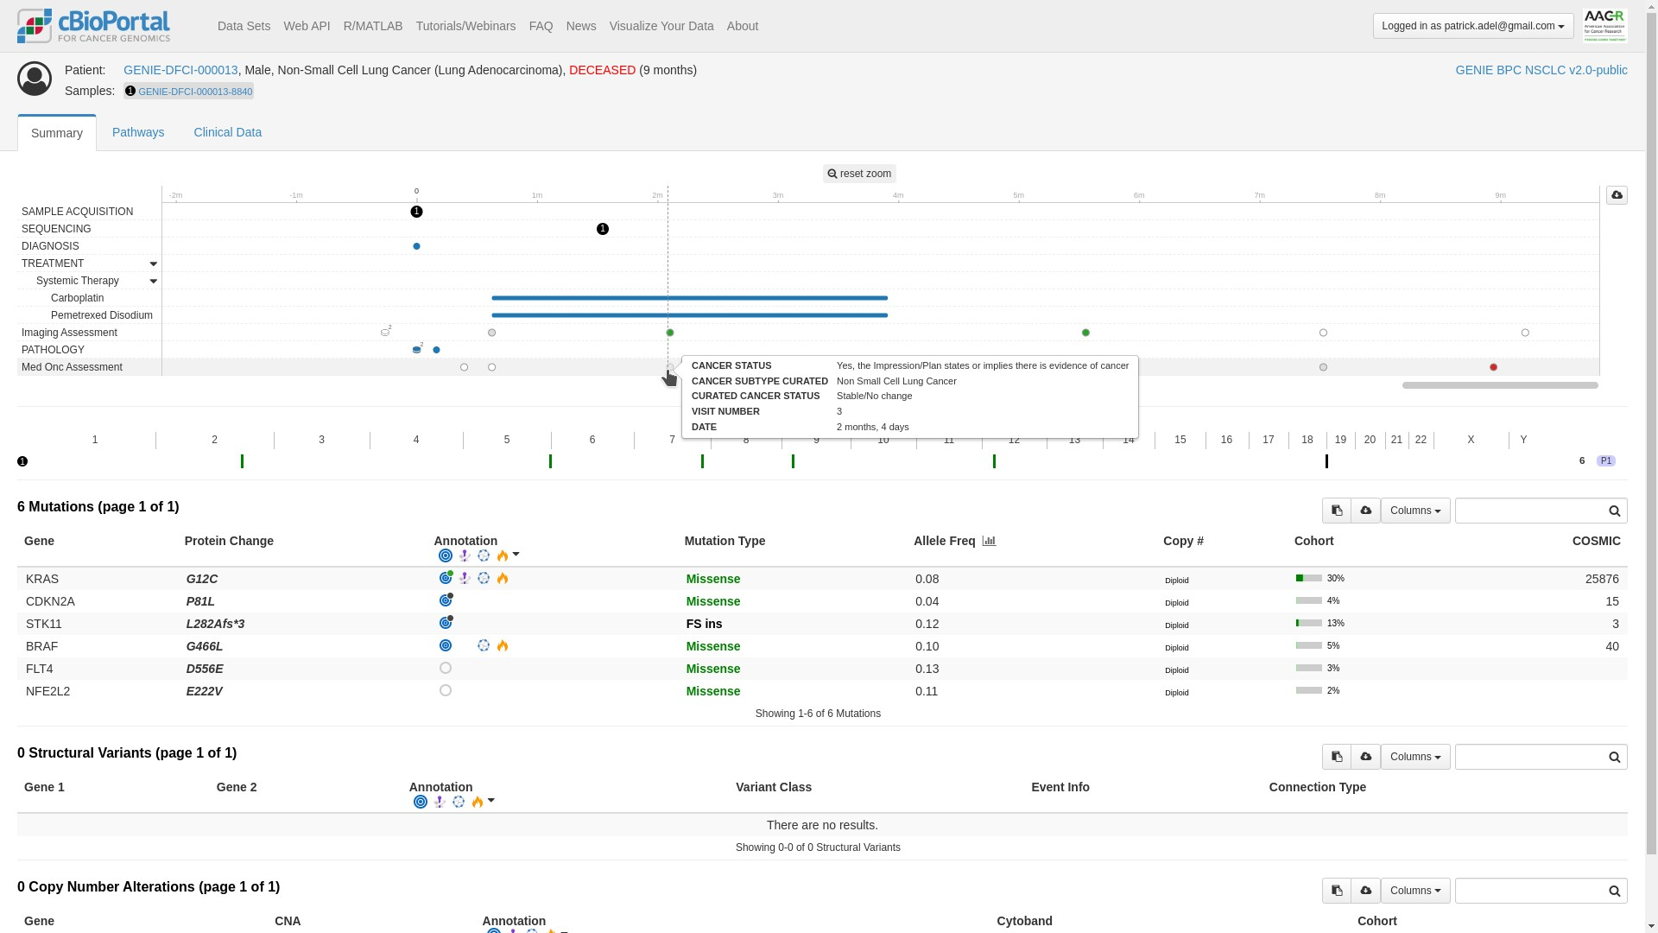
Future Work
CBioPortal, https://genie.cbioportal.org/

Slide 30
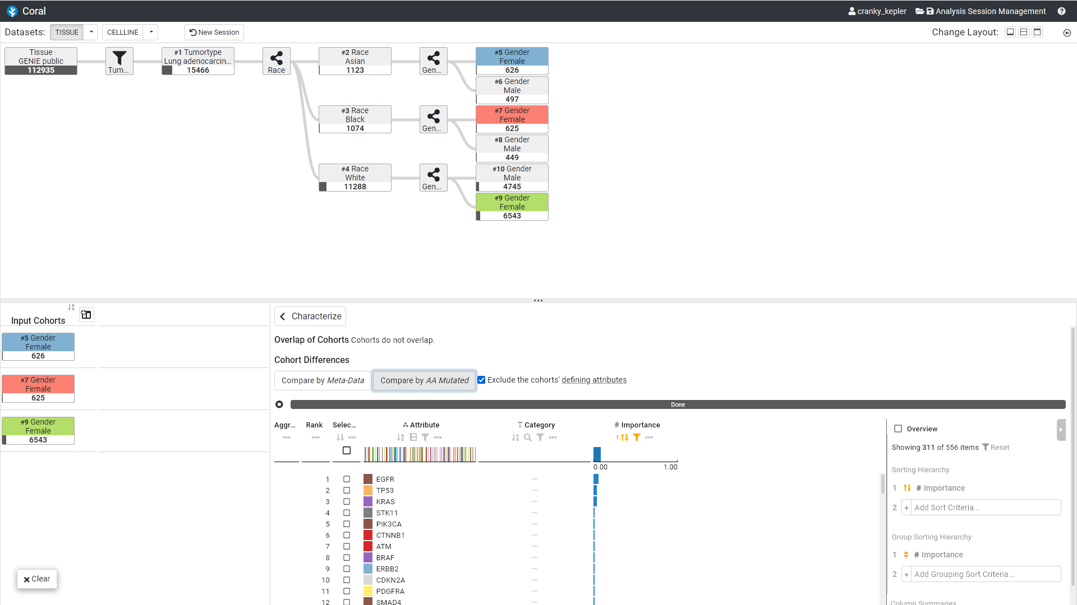
Future Work
CBioPortal, https://genie.cbioportal.org/

Slide 31
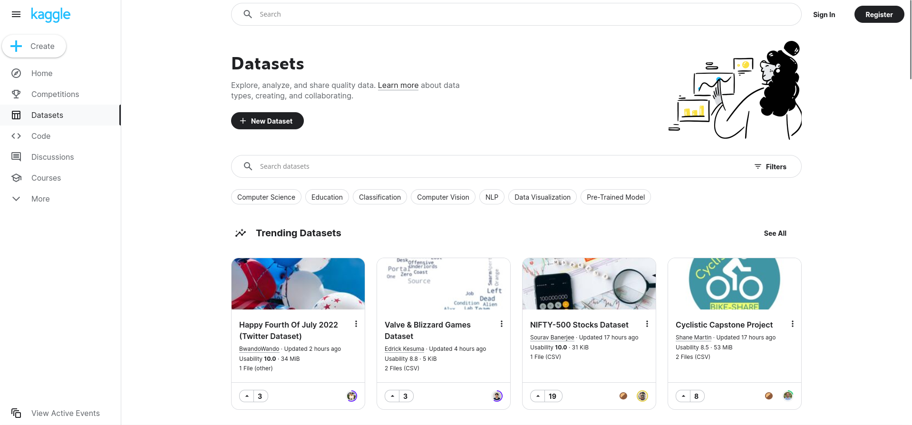
Future Work
CBioPortal, https://genie.cbioportal.org/
Kaggle, https://www.kaggle.com/datasets

Slide 32
Coral Web-based Visual Analysis Tool for Creating and Characterizing Cohorts
Patrick Adelberger, Klaus Eckelt, Markus J. Bauer, Marc Streit, Christian Haslinger, and Thomas Zichner
https://jku-vds-lab.at/biovis22-adelberger
patrick.adelberger@jku.at

